Slide 1
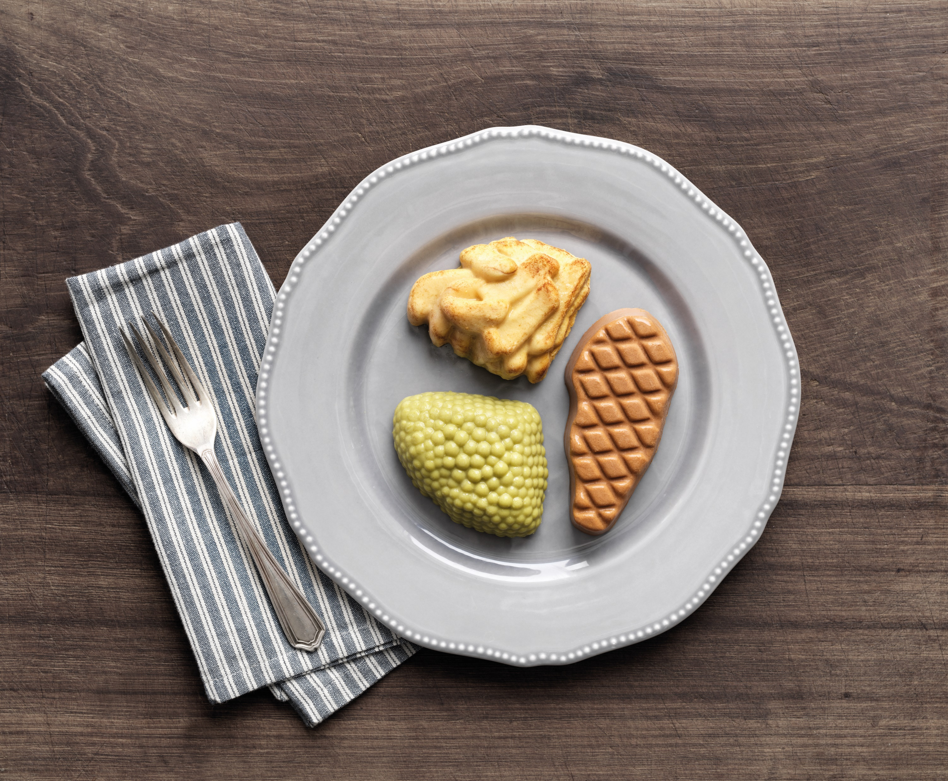

An introduction to IDDSI
and Dysphagia

Slide 2



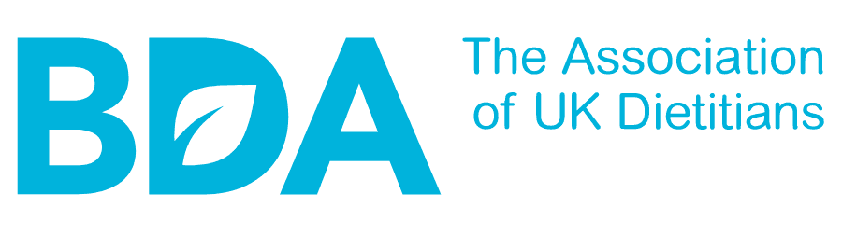
Our Expertise
Working in partnership with IDDSI since 2014
Corporate Sponsor​
In-house Dietitians and Expert Chefs​
​
Wide consultation with other HCPs on meal design
Working closely with governing bodies
Award winners!

Slide 3
Purpose of Session
Build understanding of dysphagia, its causes and its effects
Discuss the risks linked to dysphagia and how these are managed
Highlight the physical, emotional and nutritional challenges dysphagia poses to the elderly
Understand the IDDSI framework for Texture Modified Food
Notes:
Background:
Living with dysphagia can have a profound impact on the residents in your homes. These residents may experience:
Unintended weight loss
Challenges with eating and drinking
Disinterest in food
Reductions in dignity and quality of life

Slide 4

Dysphagia Facts and Figures
Defined as difficulty swallowing
From the Greek words ‘dys’ meaning difficulty and ‘phagia’ meaning to eat
1 in 17 people develop dysphagia across their lifetime ^{[1]}
Prevalence of up to 68% of those living in nursing homes ^{[2]}
Notes:
1 in 17 fact: [1] Holland G, Jayasekeran V, Pendleton N, Horan M, Jones M, Hamdy S. Prevalence and symptom profiling of oropharyngeal dysphagia in a community dwelling of an elderly population: a self- reporting questionnaire survey. Dis Esophagus 2011; 24: 476–80.
[2] Livia Sura, Aarthi Madhavan, Giselle Carnaby, Michael A Crary (2012), Dysphagia in the elderly: management and nutritional considerations, Clinical Interventions in Ageing.

Slide 5
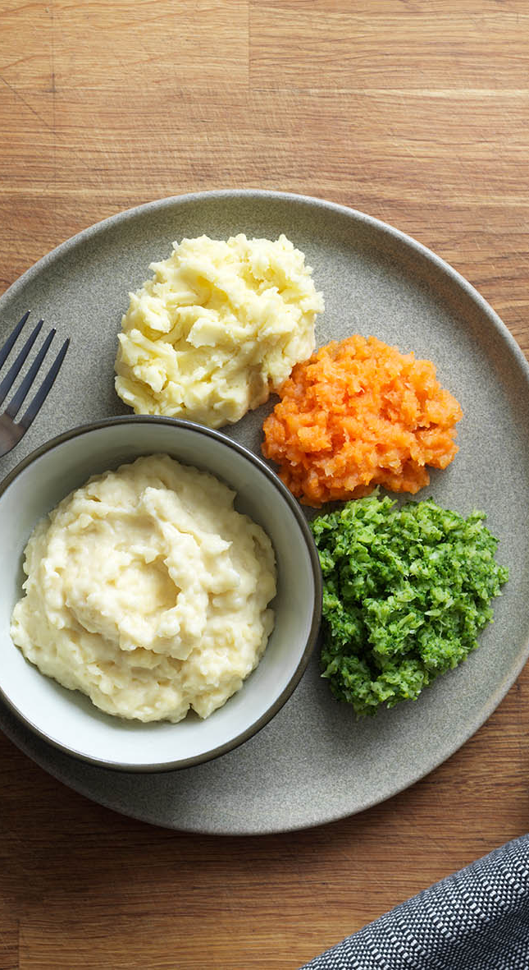
The Healthy Swallow
  On average we swallow 600 times a day
  Swallow reflex uses many muscles & nerves
  Food & drink from mouth to Stomach via Pharynx and Oesophagus avoiding airway and Lungs
Notes:
Many swallows a day, we don’t usually give it a second thought
However it’s a very complicated process involving many nerves and muscles
Normally, Food travels through the mouth, down the oesophagus to the stomach and should avoid the airway and lungs

Slide 6
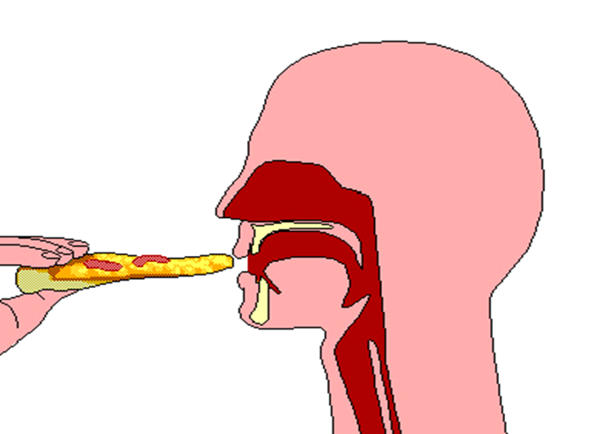
The Stages of Swallowing
A swallow can be broken into three stages:
  Pre-oral (Before the mouth)
  Oral (In the mouth)
  Pharyngeal phase (Moving to the stomach)
Notes:
Brief talk-through of each stage (only pre-oral stage will have another slide), e.g. for oral and pharyngeal stages, mention the steps involved (some voluntary, some involuntary) in order to swallow successfully

Slide 7


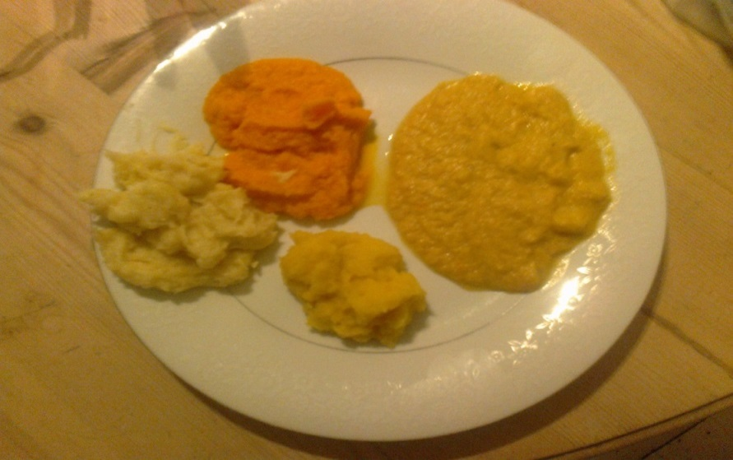

The Pre-Oral Stage
Your brain prepares your body for eating by providing sensory information which stimulates saliva production and gut motility.
Notes:
Pre-oral stage = smell/vision,
Stimulates physiological smell. The smell of your favourite food makes your mouth water in preparation/anticipation for eating and digestion.
Poorly blended food can upset this and reduce appetite.
Our meals are moulded to be much more visually appealing and can be a welcomed change for those on a TM diet

Slide 8


What can cause dysphagia?

Slide 9
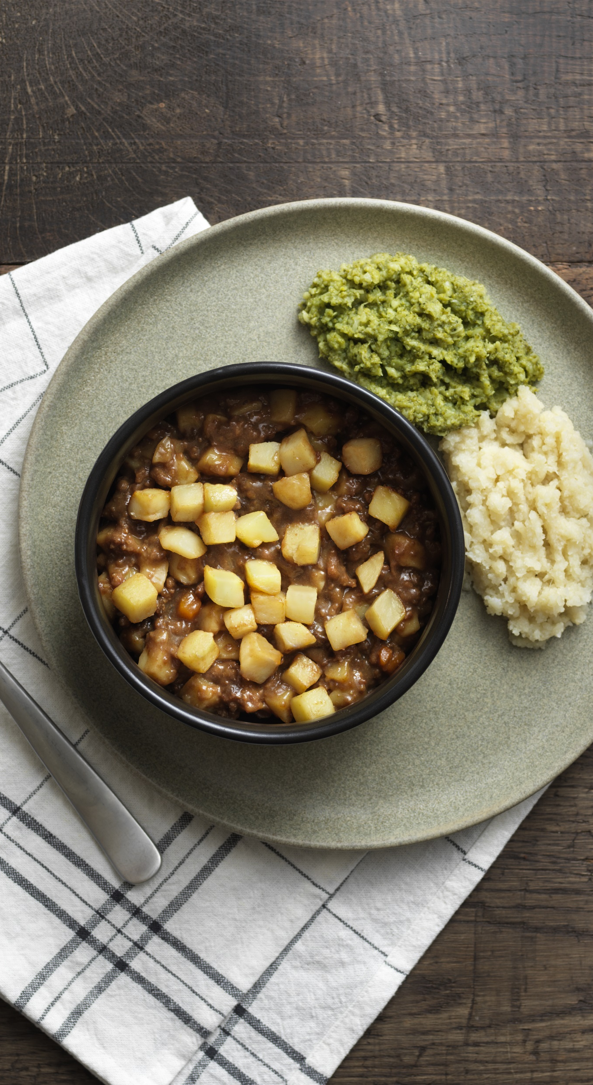
Dysphagia is a Secondary Condition…
  Stroke
  Head & Neck cancer
  Head injury
  Learning Difficulties
  Dementia
  Chronic Obstructive Pulmonary Disease (COPD)
  Acid reflux
  Ageing (Presbyphagia)
  Other conditions where there is nerve damage:
    Parkinson’s disease/MND
    Multiple Sclerosis
Notes:
Run through them
COPD = chronic obstructive pulmonary disease (respiratory disease)
(Might find it hard to breath and swallow = risk of aspiration)

Slide 10
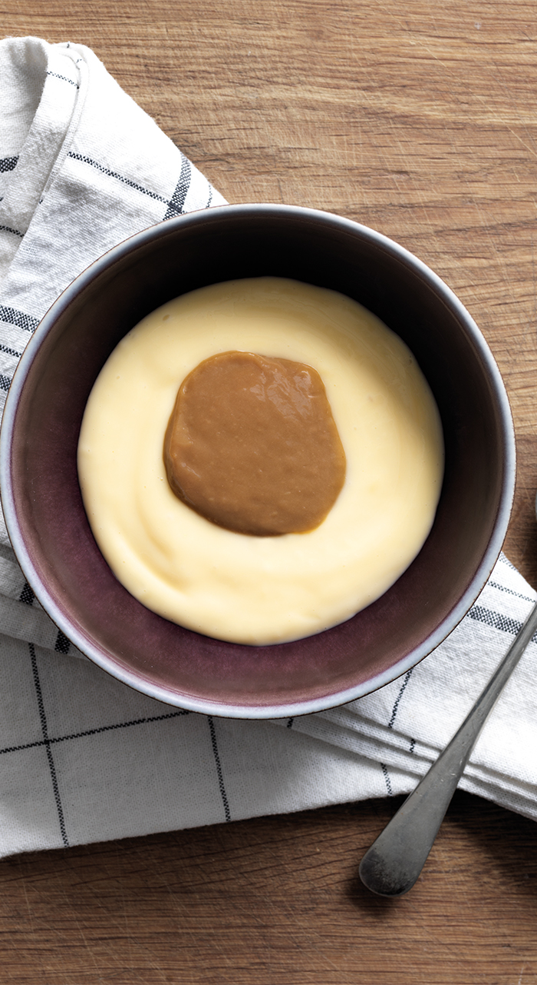
Signs and Symptoms
Silent?
Coughing or choking whilst dining
Regurgitating, sometimes through the nose
The sensation that food is stuck in your throat or chest
Uncontrollable saliva production/drooling
Difficulty or inability to chew food properly
Challenging behaviour at mealtimes/food refusal without other clear cause
A 'gurgly’ or wet sounding voice
Frequent throat clearance/multiple attempts to swallow
Frequent or persistent chest infections
Notes:
State the stages of chewing
Crux of this slide is there are lots of intricate steps that provide many rooms for inabilities to arise
TM food is easer to swallow as dysphagia impedes some of these steps

Slide 11
Risks of Dysphagia
Notes:
Going to go over some of the risks of dysphagia, split into immediate/overt risks, longer-term risks and risks related to QOL

Slide 12
Immediate Risks
Choking
Aspiration
Choking
Aspiration

Slide 13
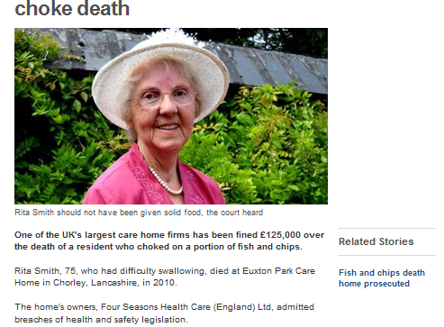
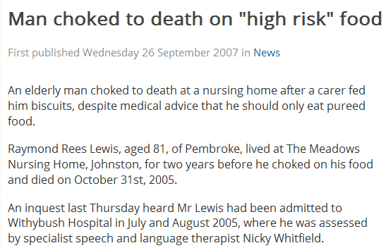
Choking
Food can block the upper airway!
In 2017, a care home was prosecuted and closed by the Quality Care Commission (CQC), after a resident choked on porridge twice in one day and died.
The CQC found the staff at the care home failed to maintain accurate care records and did not pass on his SALT (Speech and Language Therapy) assessment to the hospital.
https://www.carehome.co.uk/news/article.cfm/id/1610058/care-homes-being-urged-to-reduce-choking-deaths
Notes:
Risk 1 = choking
Care homes fined 125k
Real risk

Slide 14
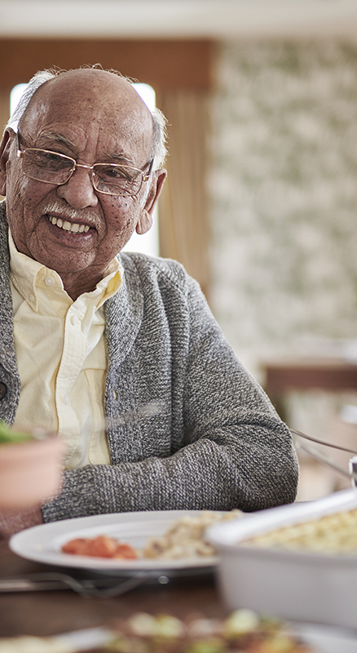
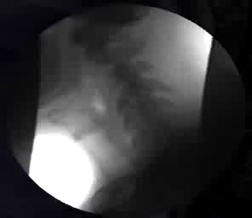
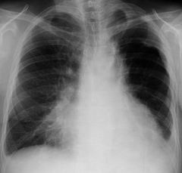
Aspiration
  Food or fluid below larynx into respiratory tract
  Normally we cough but this can be ‘silent’
  Can cause aspiration pneumonia or severe & repeated chest infections
Notes:
Aspiration = food or fluid travelling into lungs instead of down the oesophagus
“food going down the wrong way” – like if you laugh whilst drinking. Have to cough it up.
Explain what is happenin in the left video- food entering the windpipe and eventually the lungs.
If this happens persistently it can harbour a perfect breeding ground for bacteria which leads to pneumonia.
Aspiration pneumonia requires urgent hospitalisation and is a common cause of death in the very elderly

Slide 15
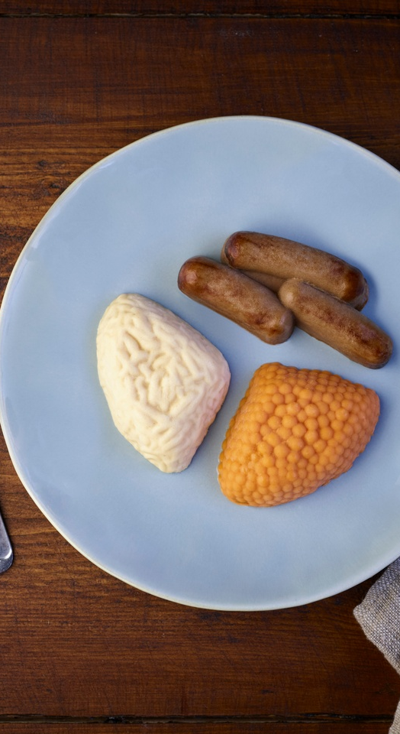
Nutritional Risks
Malnutrition
Dehydration

Slide 16

Nutritional risks: Malnutrition
and Dehydration
People receiving TM diets and fluids frequently fail to meet their needs for nutrition and fluid, and have an increased risk of malnutrition​
Notes:
Well evidence-based information; various studies have been done in hospital and care home environments that show that people on TM diets don't tend to finish their meals, and often don't get provided with the correct meal in the first place. In one study done in the UK, older people on TM diets only met half of their requirements for energy and protein – significant deficit, likely to lead to malnutrition/dehydration.
Nowson CA, Sherwin AJ, McPhee JG, Wark JD, Flicker L. Energy, protein, calcium, vitamin D and fibre intakes from meals in residential care establishments in Australia. Asia Pac J Clin Nutr. 2003;12(2):172-177.

Slide 17

Dysphagia risks: Causes of Malnutrition
Fear of eating and drinking
Fear of choking
Discomfort when eating and drinking
Embarrassment about physical effects of dysphagia
Change in flavours/textures
Fatigue when eating
Effects from location of stroke
Notes:
A brief look at ways in which dysphagia could lead to a reduction in food & fluid intake, which could, in turn, lead to malnutrition and dehydration
Effects on the location of stroke and how this can impact nutritional intake - examples:
Visuospatial perceptual, this can be frightening for the person and can lead to them E&D less

Slide 18
The Impact of Malnutrition
Twice as often
3 days/40% longer
Poor healing
More falls/poor mobilisation
More prescriptions
Poor immunity- effects can be seen within a few days
Notes:
People who are malnourished typically:
Visit the GP twice as often
Stay in hospital 3 days, or 40% longer
Experience poor/delayed wound healing and reduced immunity
Experience more falls
Collect more prescriptions
Highlight that this presentation isn’t specifically covering many of the details of malnutrition (warrants a separate pres), although there is a need to highlight the consequences, due to the association between dysphagia & malnutrition

Slide 19
Impacts of Dysphagia
Reduction in/ loss of dignity
Reduced QOL

Slide 20
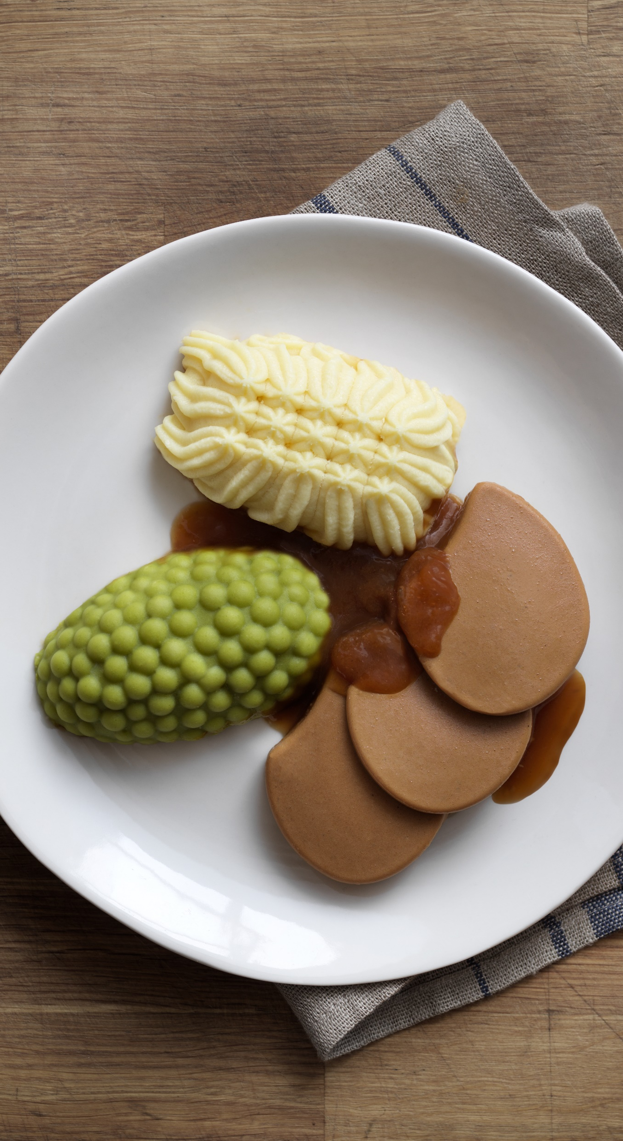
Dysphagia Risks: Impact on QOL
Need for assistance
Loss of dignity
Social isolation
Confusion or low mood
Notes:
Dysphagia or its causes can lead to... list all points and expand on them – reasons why, the effects this can have

Slide 21

Complications of dysphagia
48%
Malnutrition
75%
Dehydration
Aspiration Pneumonia is a major cause of death in the elderly
51%
Aspiration
22%
Aspiration Pneumonia
Notes:
Stroke victims with dysphagia have been shown:
Half are malnourished
¾ dehydrated
Half are aspirating food/fluid
Nearly ¼ experience aspiration
At least 5 percent of people who are hospitalized for aspiration will die. Among geriatric populations, mortality skyrockets. A 2013 study of elderly patients put 30-day mortality at 21 percent.
HSTAT https://www.ncbi.nlm.nih.gov/books/NBK33017/
Felt (2006) Nutritional Management of Dysphagia in the Healthcare Setting. Healthcare Caterer. Vol 1. Issue 2. http://www.cmai.ie/Downloads/HCINewsletter%20V1%20Issue%202%20Spring%202006.pdf
Leibovitz et al (2007) Dehydration among long-term care elderly patients with oropharyngeal dysphagia. Gerontology. 53:179-183. https://www.ncbi.nlm.nih.gov/pubmed/17264513
Wright L, et al. (2006).Comparison of energy and protein intakes of older people consuming a texture modified diet with a normal
hospital diet. Journal of Human Nutrition and Dietetics; 18: 213–219. https://www.ncbi.nlm.nih.gov/pubmed/15882384
Sura L, et al. (2012).Dysphagia in the elderly: management and nutritional considerations. Clinical Interventions in Ageing; 7: 287-298 https://www.ncbi.nlm.nih.gov/pubmed/22956864

Slide 22
Why Texture Modify?

Slide 23
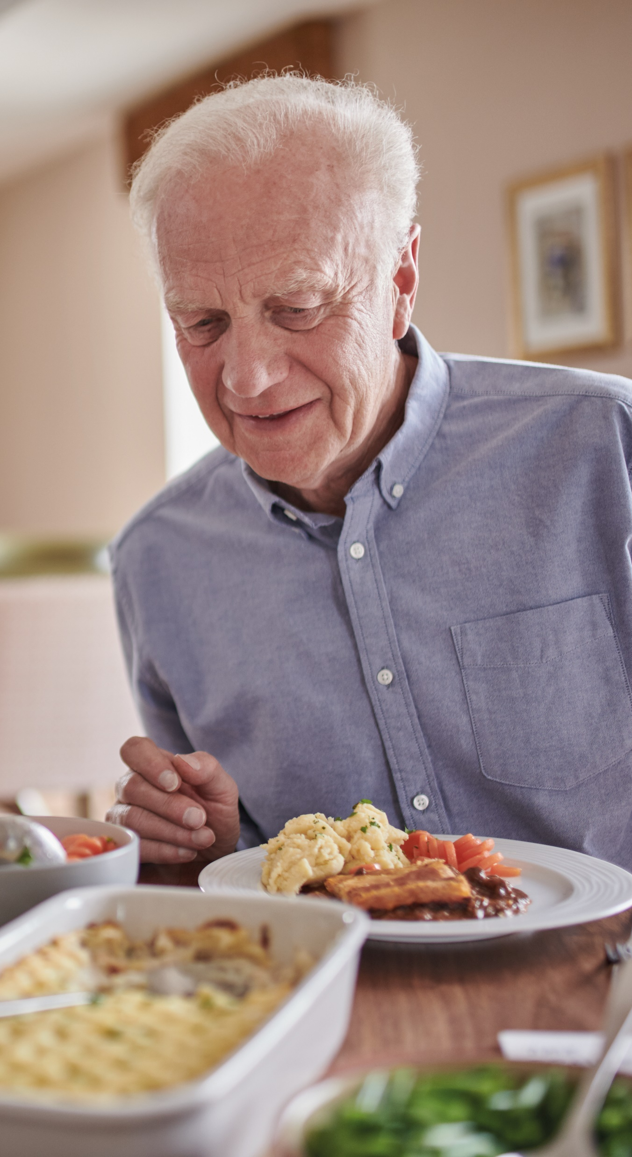
Why do we modify textures in dysphagia management?
  Changes to texture of food & fluid: individually determined by SLT
  Correct texture must be provided as part of the care standards (CQC)
  Reduces risk of aspiration & choking
  Reduce the risk of malnutrition
  Also consider…
  Individual food preferences still need to be met
  May progress back to a normal diet
Notes:
SLT = speech and language therapist
CQC – care quality commission

Slide 24
IDDSI Framework

Slide 25
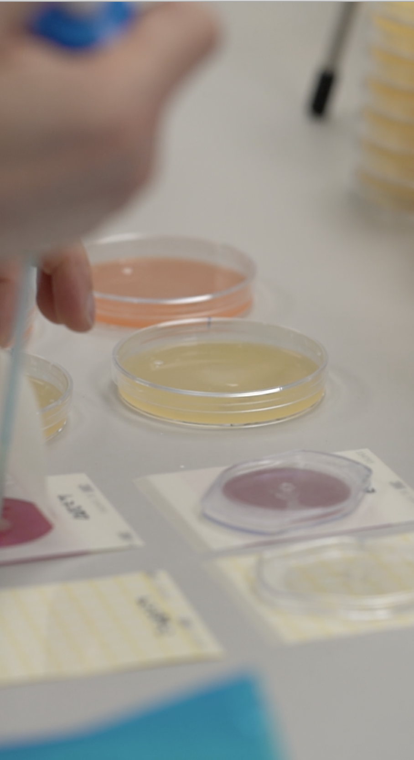
What is IDDSI?
  An international collaboration of dietitians, SLTs, food scientists, physicians, OTs, engineers, nurses and industry professionals.
  The objective was to create a global standard for categorising texture modified foods for people with dysphagia
  The aim is to have a common language that can be used for all
  Widely in use
Notes:
A collaboration of HCP’s and industry to produce a global standard for texture modified food and drinks for those with dysphagia. It’s aim is to be the universal language for all that have input into producing, serving and eating TM foods

Slide 26
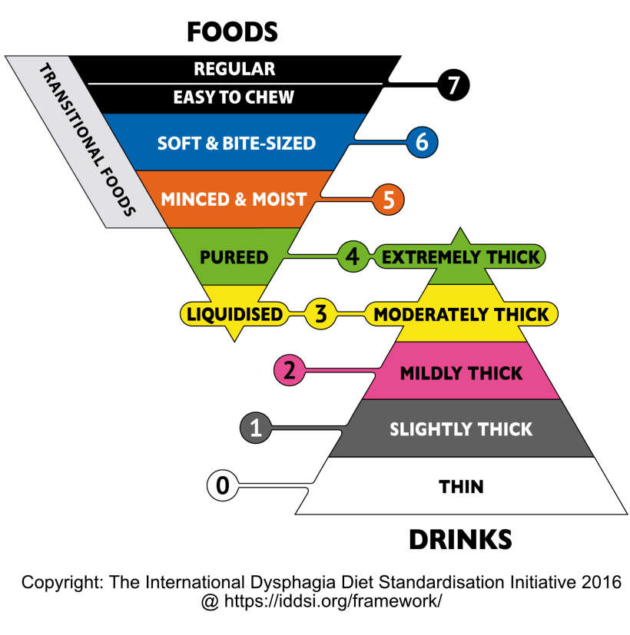




The IDDSI Framework
  A continuum of 8 levels (0-7) including both foods and drinks
  Drinks are measured from levels 0-4
  Foods are measured from levels 3-7
  Cross-over in the middle
Notes:
IDDSI:
IDDSI works on 8 ‘levels’ → 0-7 with drinks being 0-4 and food 3-7
Cross over at level ¾ for things like soups/puddings
We don’t do drinks so will be focussing on food levels 3-7

Slide 27
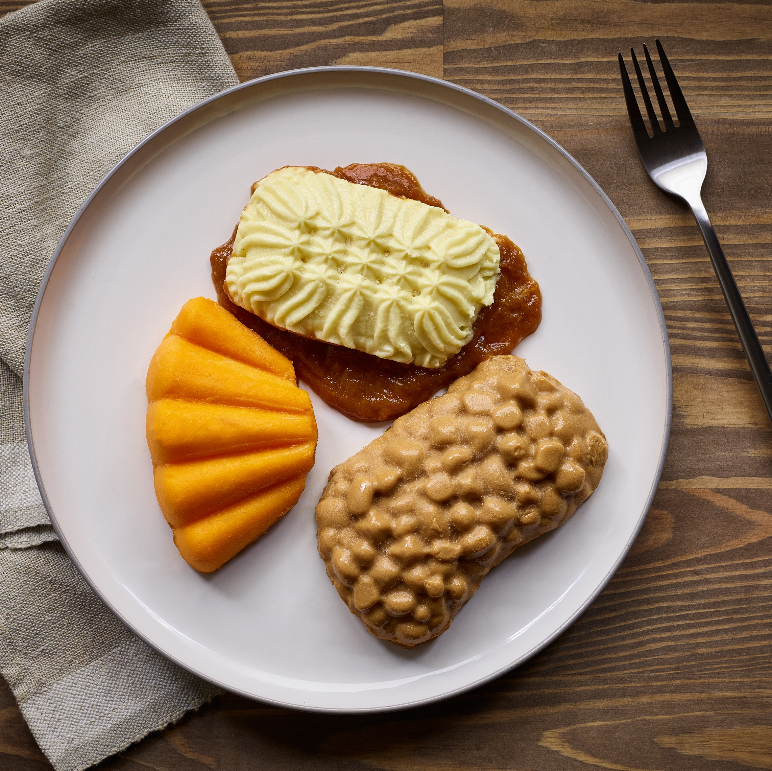
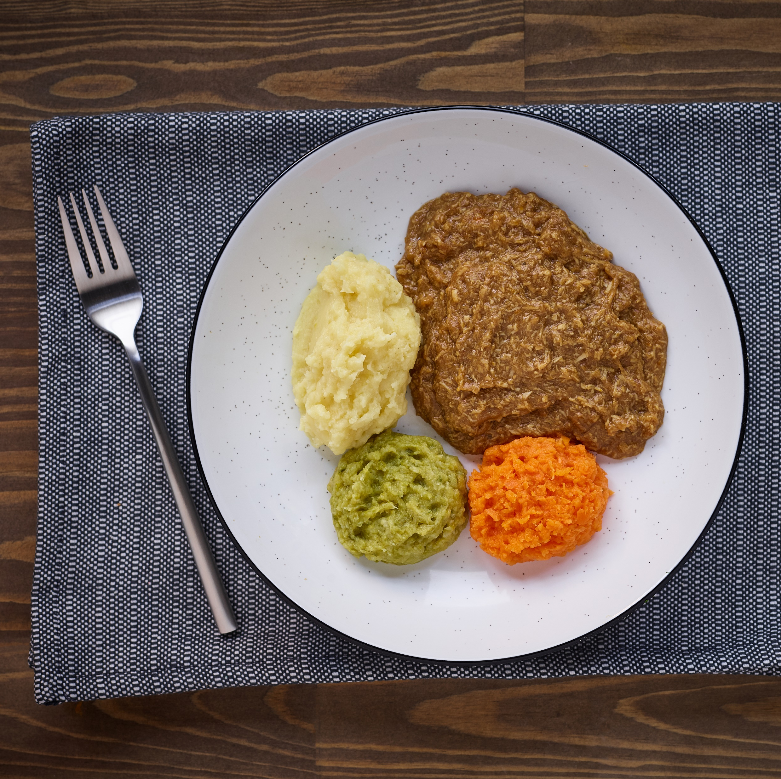
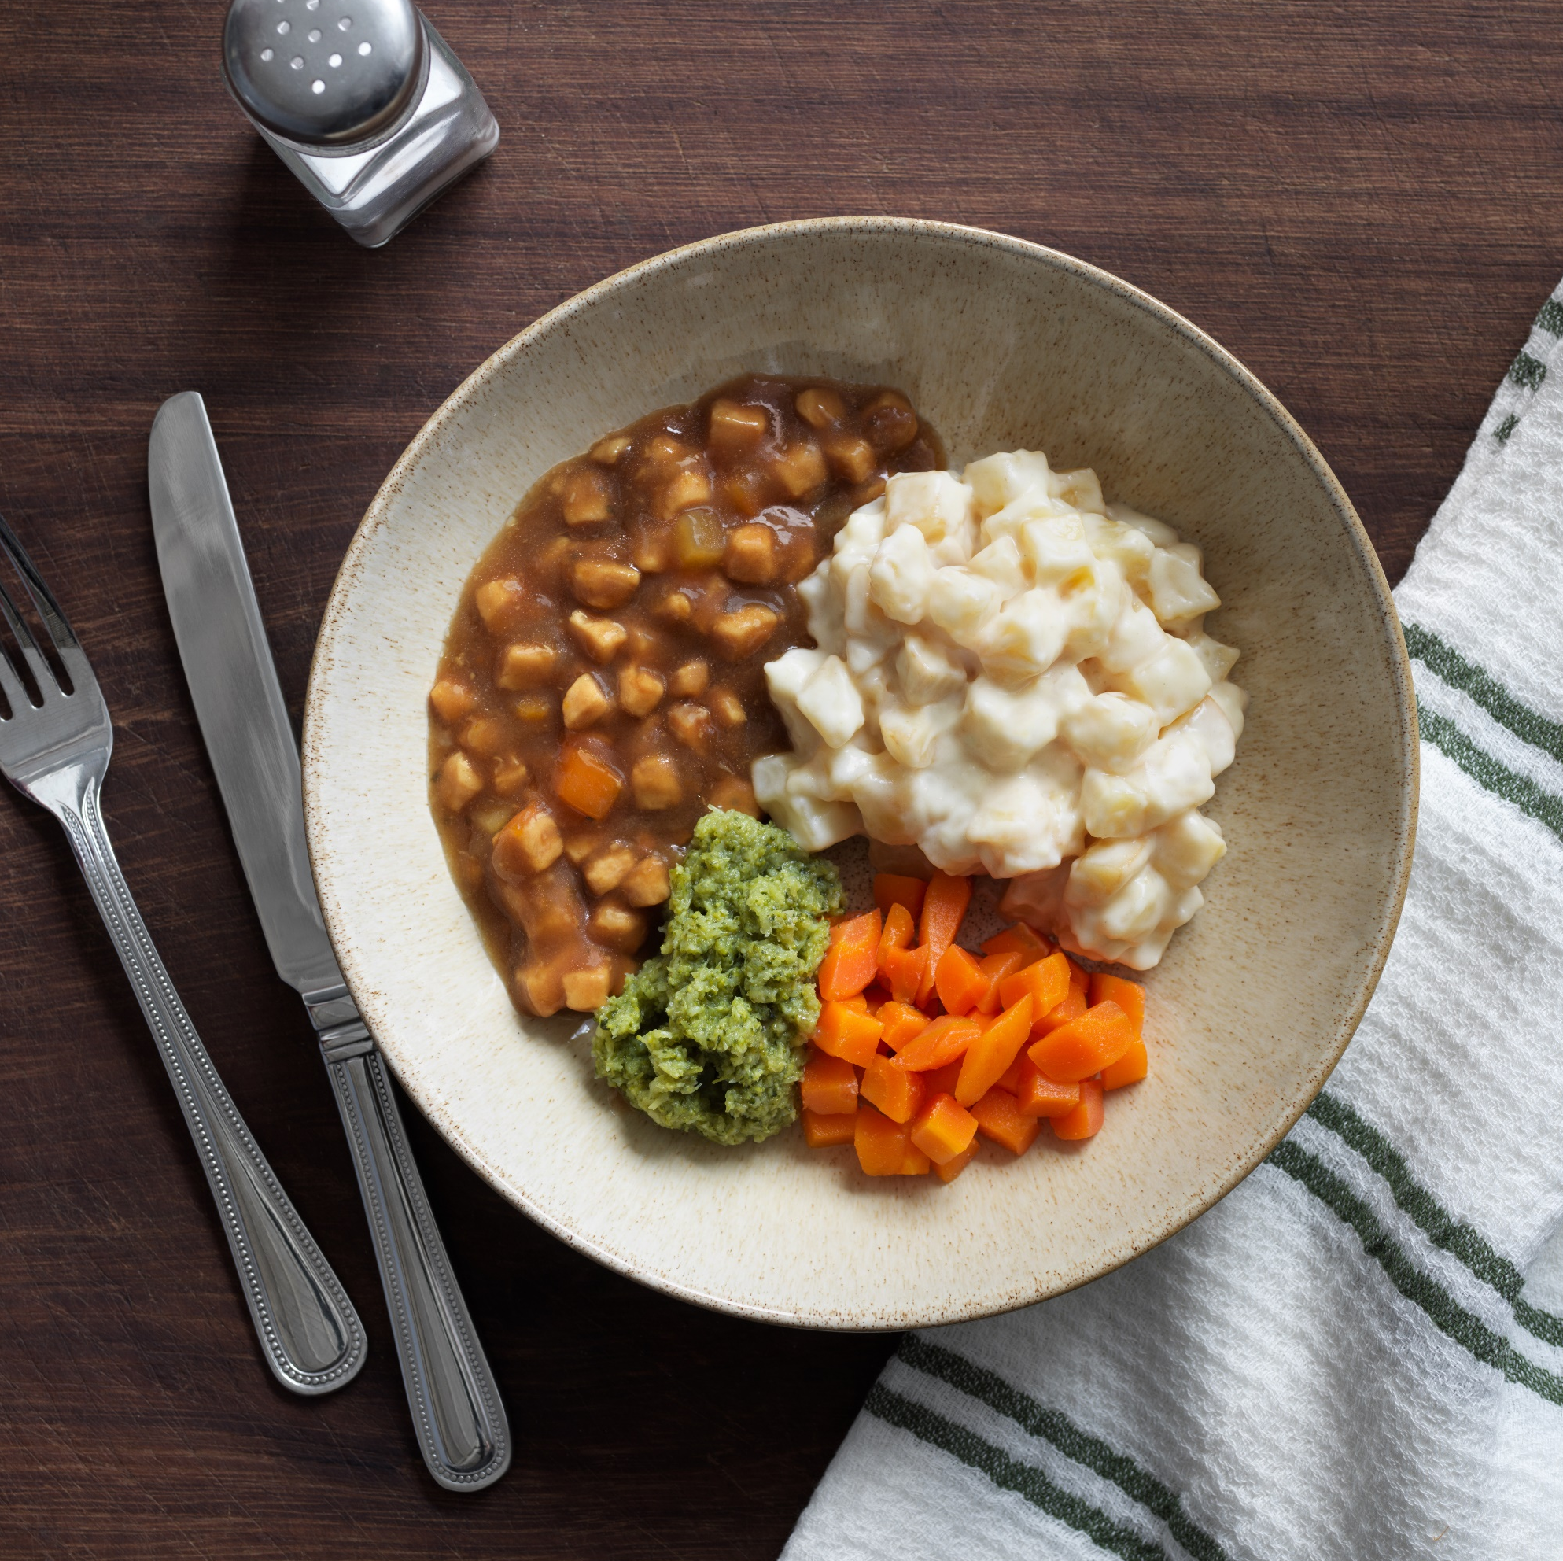
The IDDSI Framework
Level 4 Purée Classic
Chicken & Vegetable Casserole
Level 5 Minced
Chicken & Vegetable Casserole
Level 6 Soft and Bite Sized
Chicken & Vegetable Casserole

Slide 28

The Properties of Level 4
IDDSI Level 4
Usually eaten with a spoon
Fall off a spoon in a single spoonful when titled and continues to hold shape on a plate
Liquid must not separate from solid
Show some slow movement under gravity but cannot be poured
Cannot be drunk from a cap
Not sticky
Not lumpy
Link to full detailed definitions: http://ftp.iddsi.org/Documents/Complete_IDDSI_Framework_Final_31July2019.pdf
Notes:
As you can see, IDDSI level 4 can be described as…

Slide 29

The Properties of Level 5
IDDSI Level 5
Usually eaten with a fork
Can be scooped and shaped on a plate
Soft & moist with no separate liquid
Small lumps visible within the food Adult: 4mm width x 15mm length maximum
Lumps are easy to squash with your tongue
Link to full detailed definitions: http://ftp.iddsi.org/Documents/Complete_IDDSI_Framework_Final_31July2019.pdf
Notes:
Read what characteristics → e.g. can be scooped and shaped on a plate, biting not required, chewing needed
Most important and significant change is that level 5 mainly consists of lumps in 4mm x15mm size for adults.
For children lump sizes are equal to or less than 2 mm width and no longer than 8mm in length
WFF Meals ONLY designed for adults specifications

Slide 30
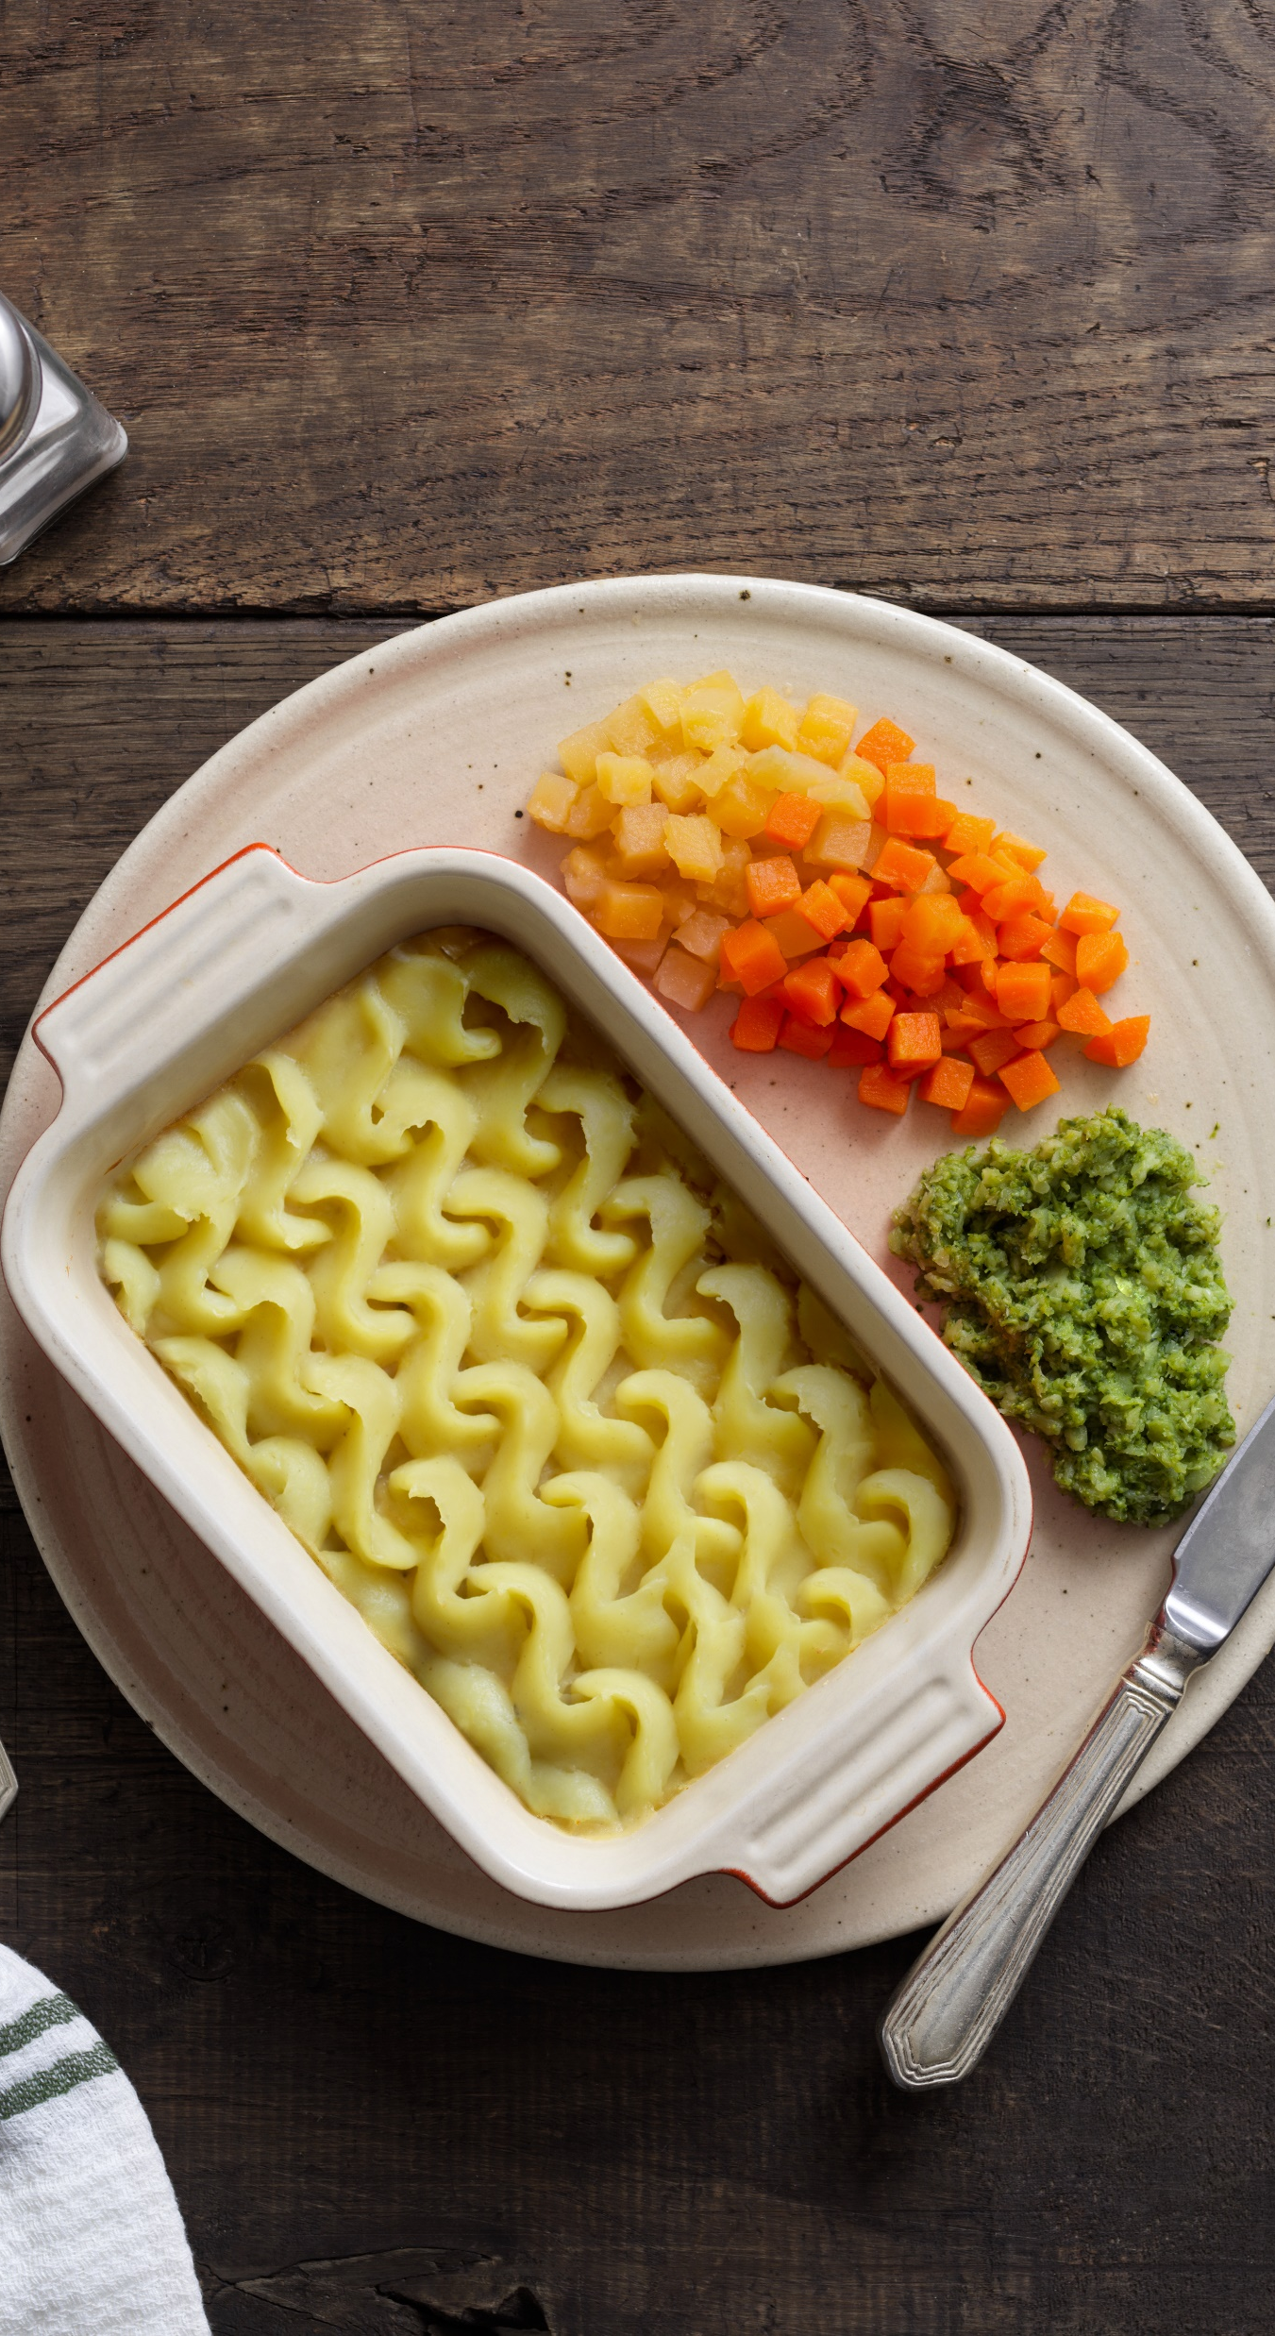
The Properties of Level 6
IDDSI Level 6
Can be eaten with a fork or a spoon
Can be mashed/broken down with pressure from fork, spoon or chopsticks
Chewing is required before swallowing
Soft, tender and moist throughout but no separate thin liquid
Bite-sized pieces as appropriate for size an oral processing skills Adults: 15mm pieces
Link to full detailed definitions: http://ftp.iddsi.org/Documents/Complete_IDDSI_Framework_Final_31July2019.pdf
Notes:
Main feature everything to be 15mm size pieces for adults.
For children: 8mm pieces (no larger than)
WFF Meals ONLY designed for adults specifications

Slide 31
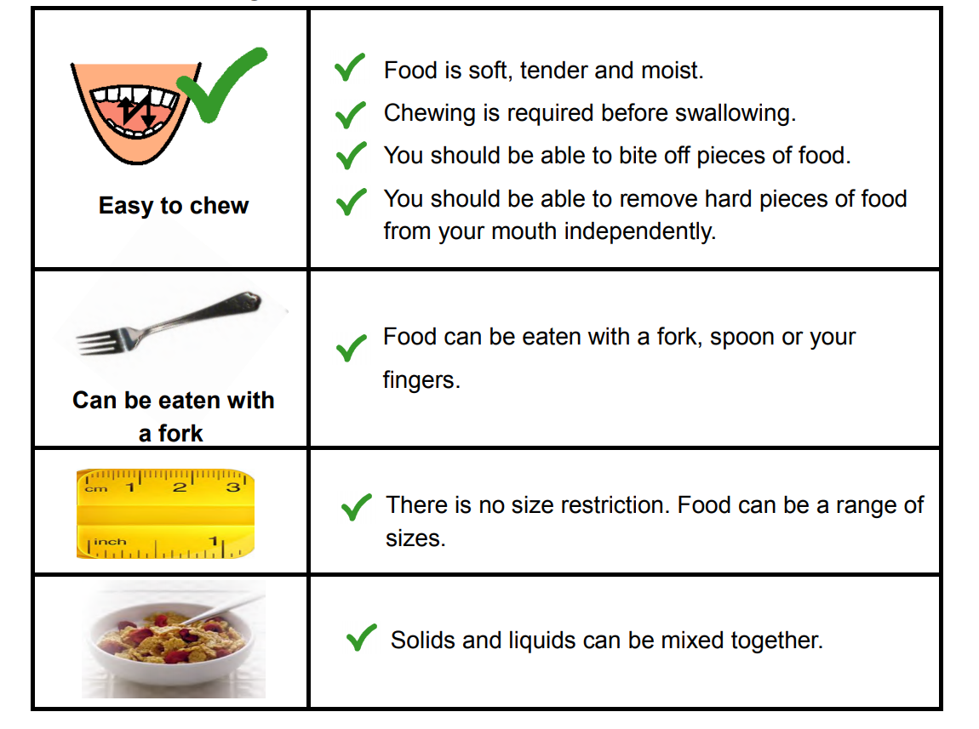
Level 7 Easy Chew
Credit: IDDSI.org
Notes:
Outline why an overview of this IDDSI level is important
- Use of term soft diet is ambiguous; patient safety alert in 2018 called for removal of vague terminology around TM diets, including ‘soft’
Physiological implications may include:
Those who find food of harder textures painful/difficult to chew/swallow, fatigue, challenging mealtime behaviours such as putting too much food in mouth, not chewing properly, eating too fast
Requires the ability to chew and orally process soft/tender foods without tiring easily, there are tests that need to be done to identify foods as E2C
Explain why/how this addition came about: feedback from SLT’s that jump from L6 to L7 regular was too big

Slide 32
Summary
Dysphagia is defined as difficulty swallowing
Dysphagia is common among Care Home residents and there are several significant associated risks
There are a variety of implications e.g. malnutrition, dehydration, quality of life
The IDDSI framework provides a common terminology to describe food textures and drink thickness

Slide 33
Notes:
Thank you- Ask if there are any questions

