Slide 1
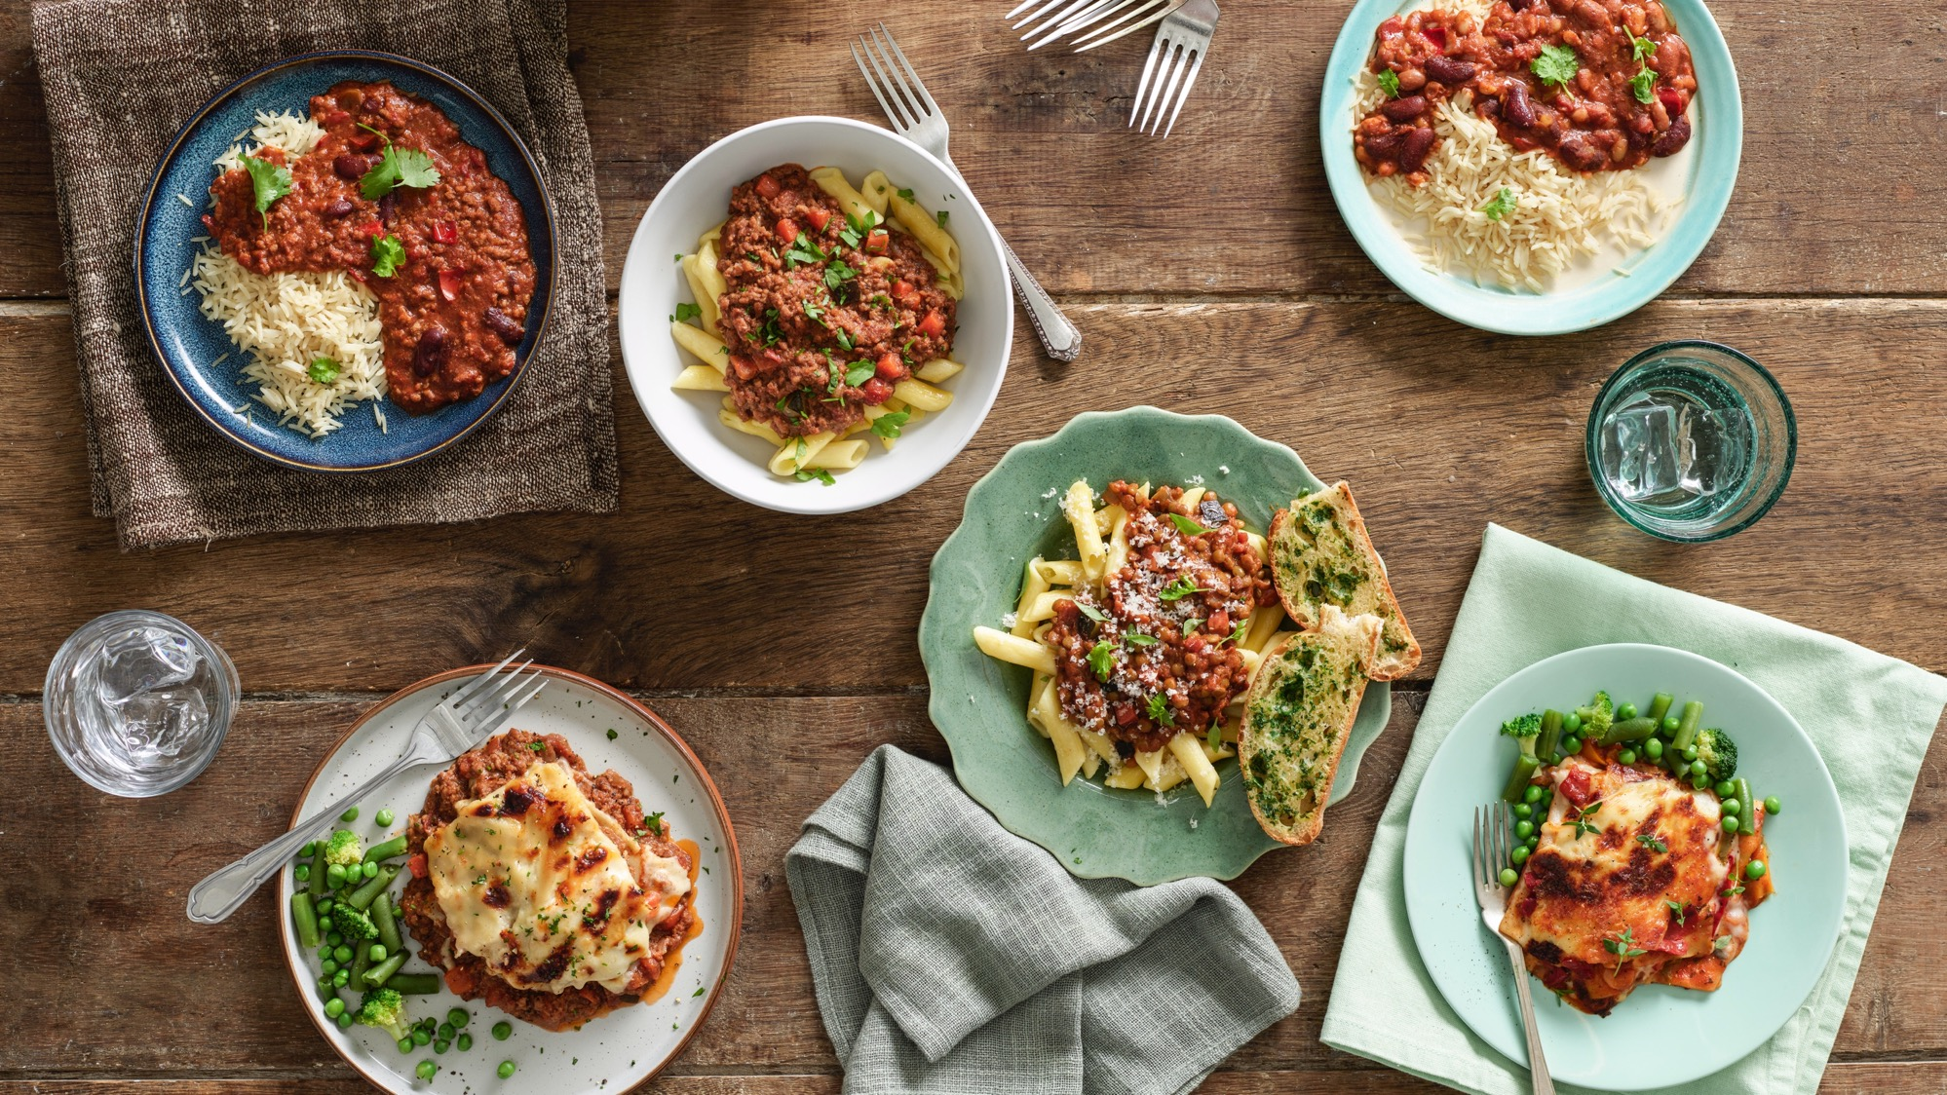

Mission Nutrition:
Building Healthy Habits
Enter Date Here

Slide 2
Lesson Breakdown
1.
2.
3.
Where does
our food come
from?
The Eatwell
Guide
Plenary
Notes:
Make clear who is for KS1 and who is KS2
Change to education deck

Slide 3



Lesson Objectives
… children will be able to name the 5 main groups of the Eatwell Guide
… children will be able to put different foods into the main groups
… children will be able to name what each food group is required for in the body
Notes:
Do we need LO?

Slide 4
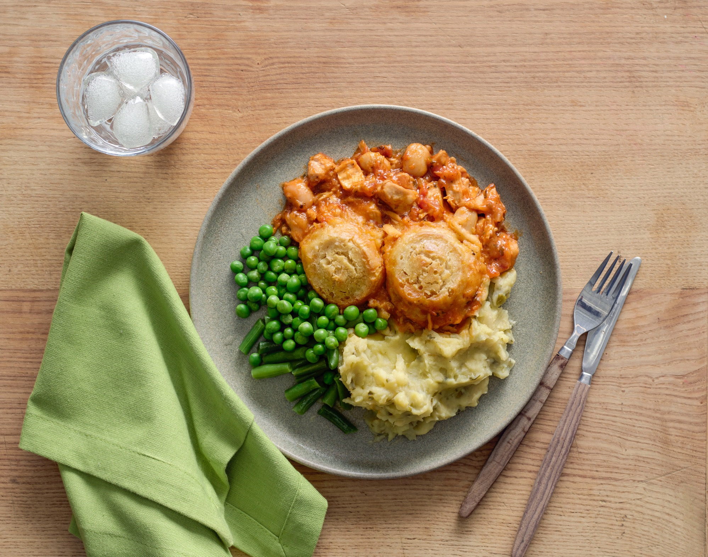

Where does our food come from?

Slide 5


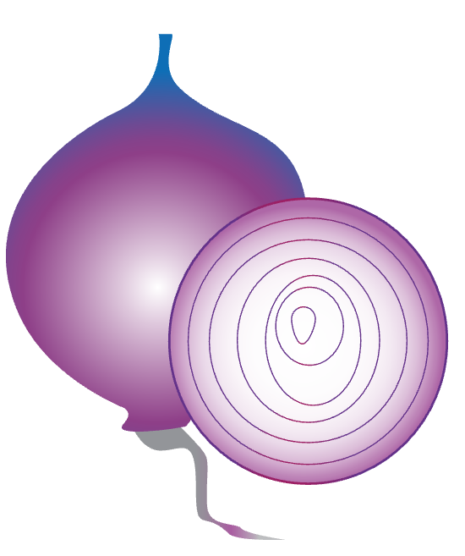
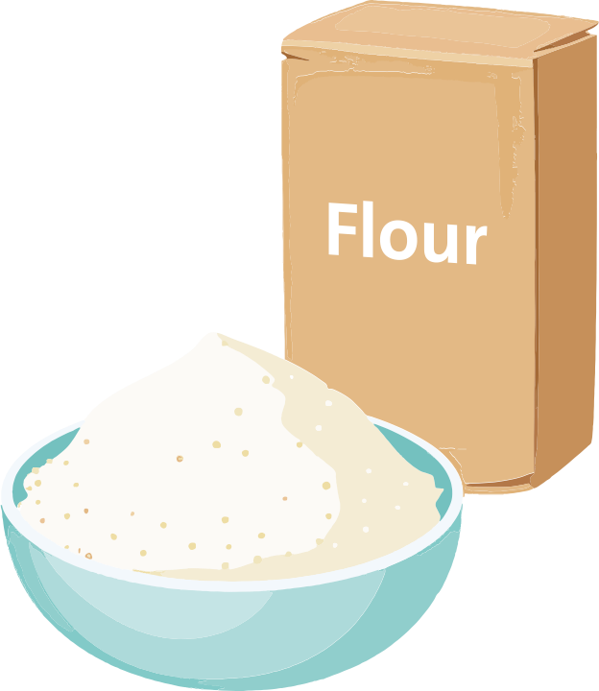


Our Ingredients….
Underground or overground?
Which animal?
Plant or animal based?
Plant or tree or bush?
Notes:
Children must name ingredients and where they come from

Slide 6
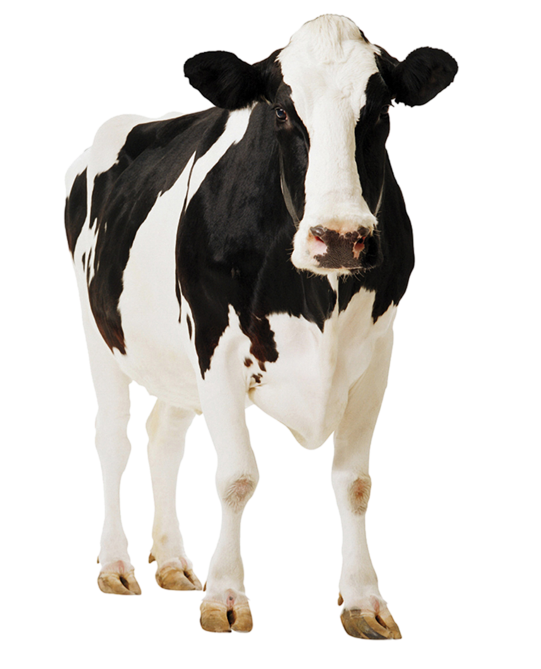
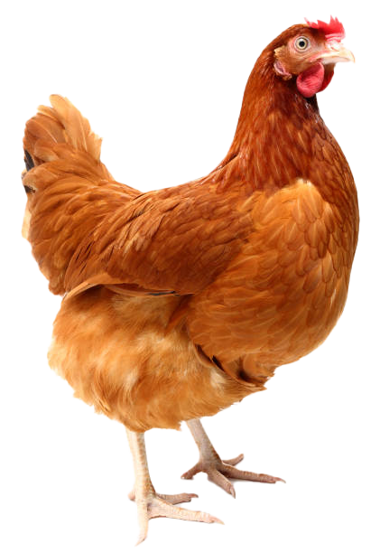
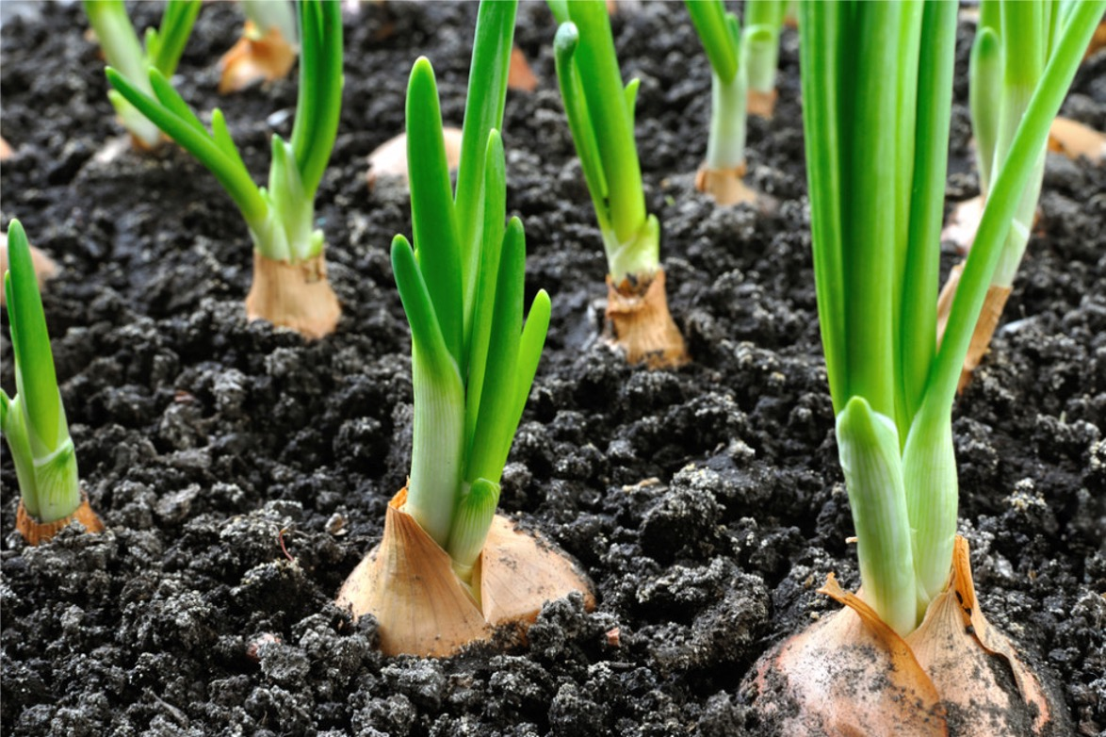
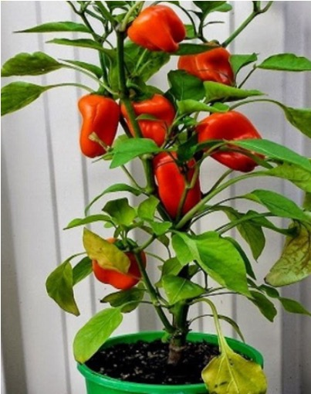
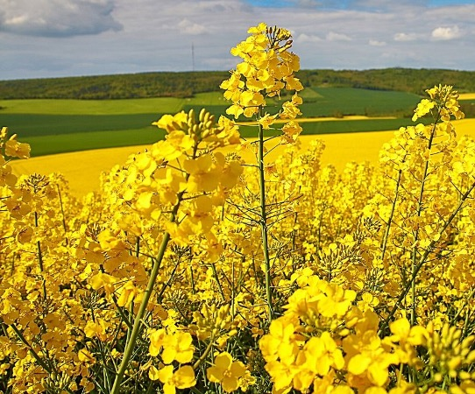
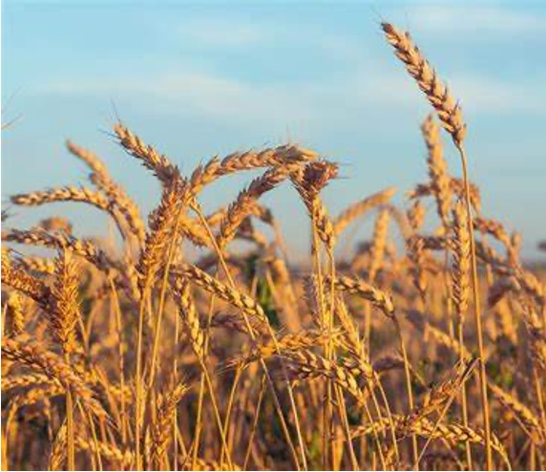
Where does it come from?
Animal
Plant
Underground
Overground

Slide 7
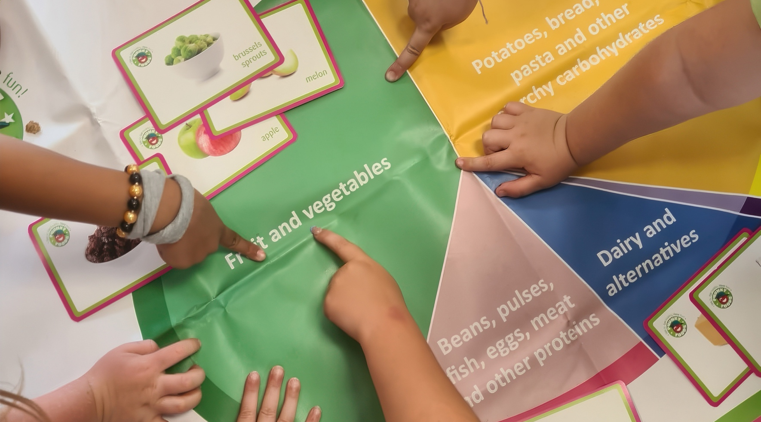
The Eatwell Guide

Slide 8
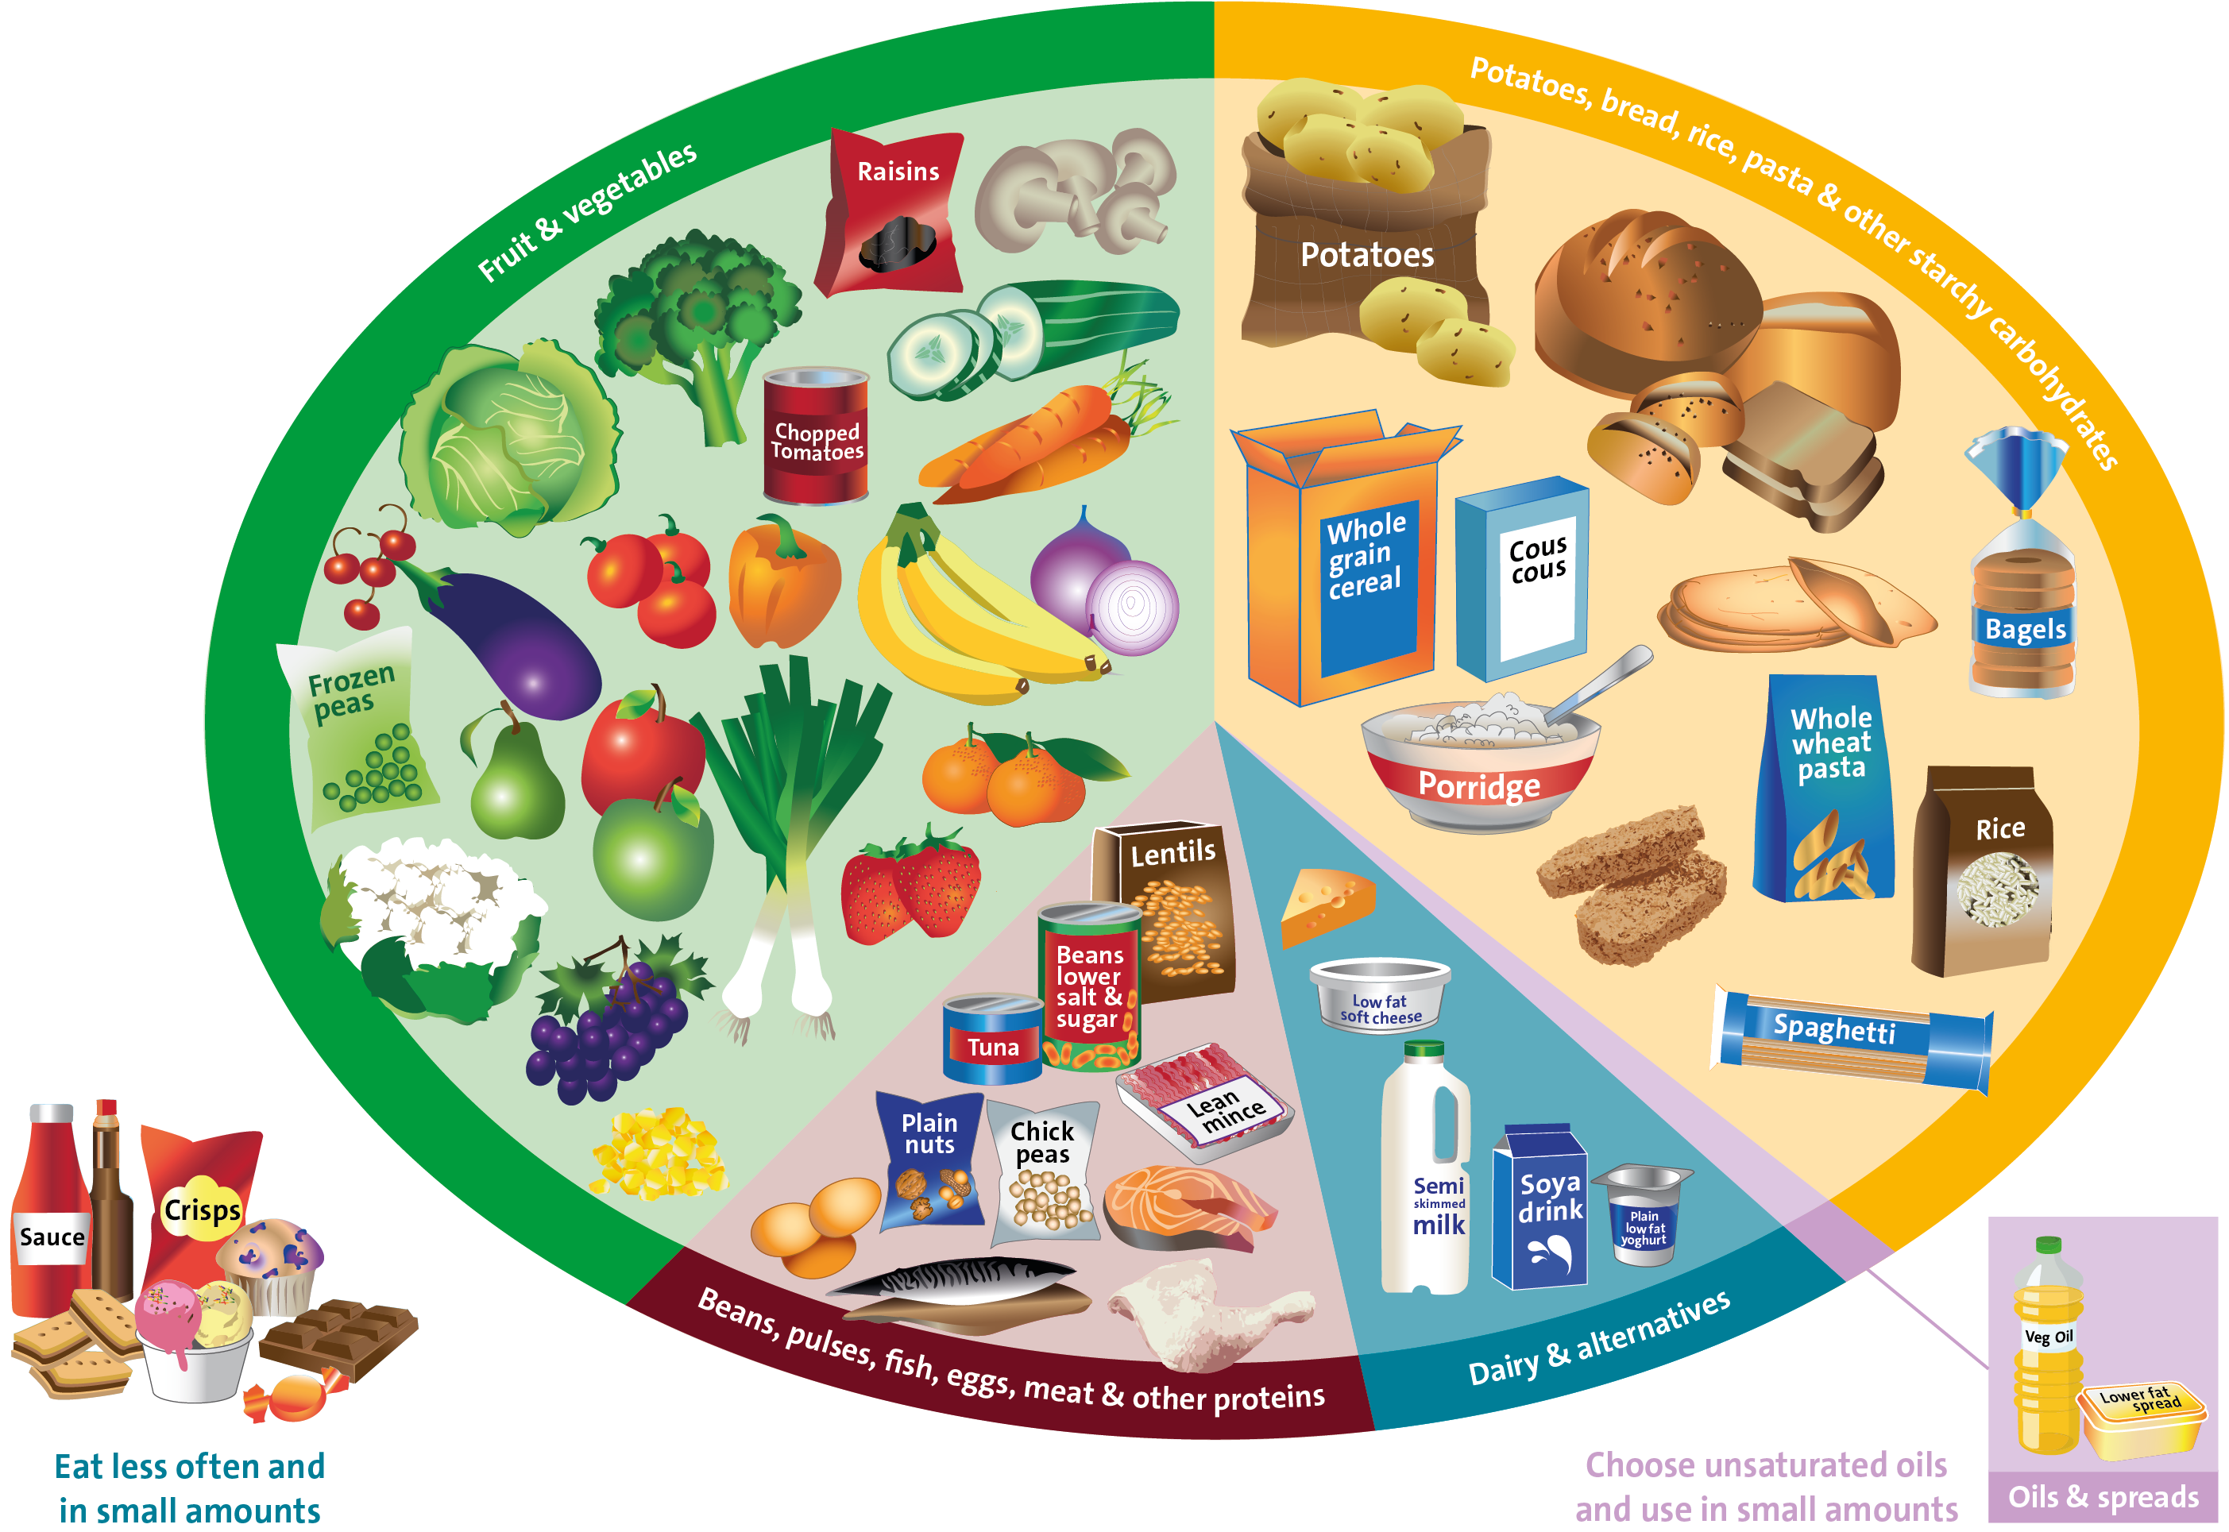
What is the Eatwell Guide?
Source: Public Health England in association with the Welsh Government, Food Standards Scotland and the Food Standards Agency in Northern Ireland

Slide 9
Where do your ingredients go?
Notes:
Animation to move the ingredients into the relevant eatwell section.
Where do the ingredients go? Children to break into groups based on the ingredients for the quiche making and go and stand on the section of the plate they believe their ingredient goes. The following section will then allow them to see where the ingredients really do go.
Answer order:
1. Red Pepper,
2. Onion
3. Cheese
4. Eggs
5. Oil
6. Flour

Slide 10
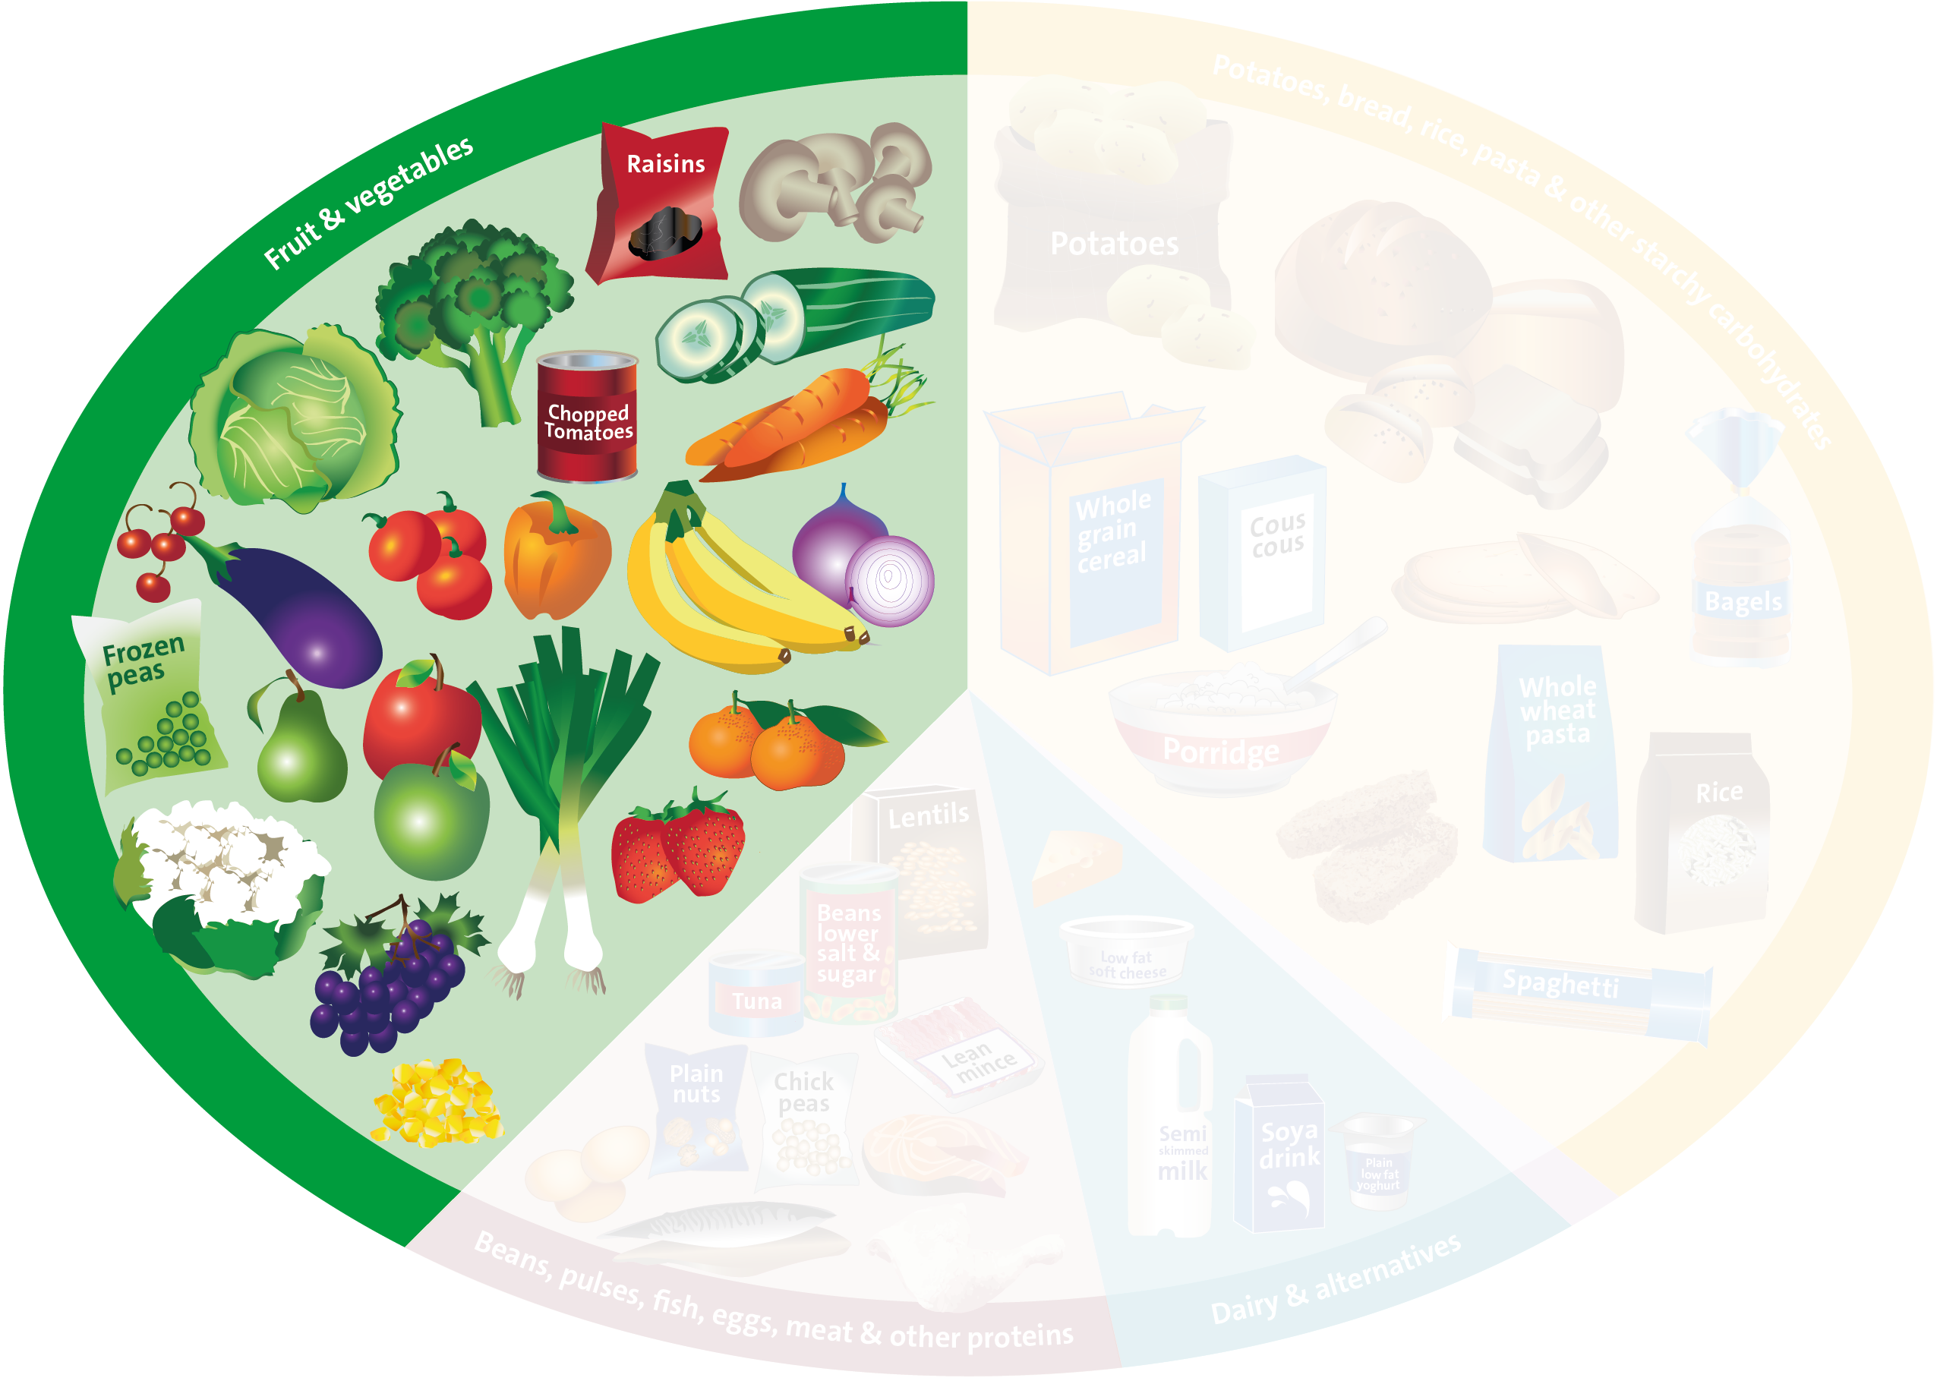


Fruit & Vegetables
What is a portion size and how many portions should we have every day?

Slide 11



Fruit & Vegetables
Which of our ingredients are fruit and vegetables?
Can you think of a fruit or vegetable that starts with the following letters?

Slide 12

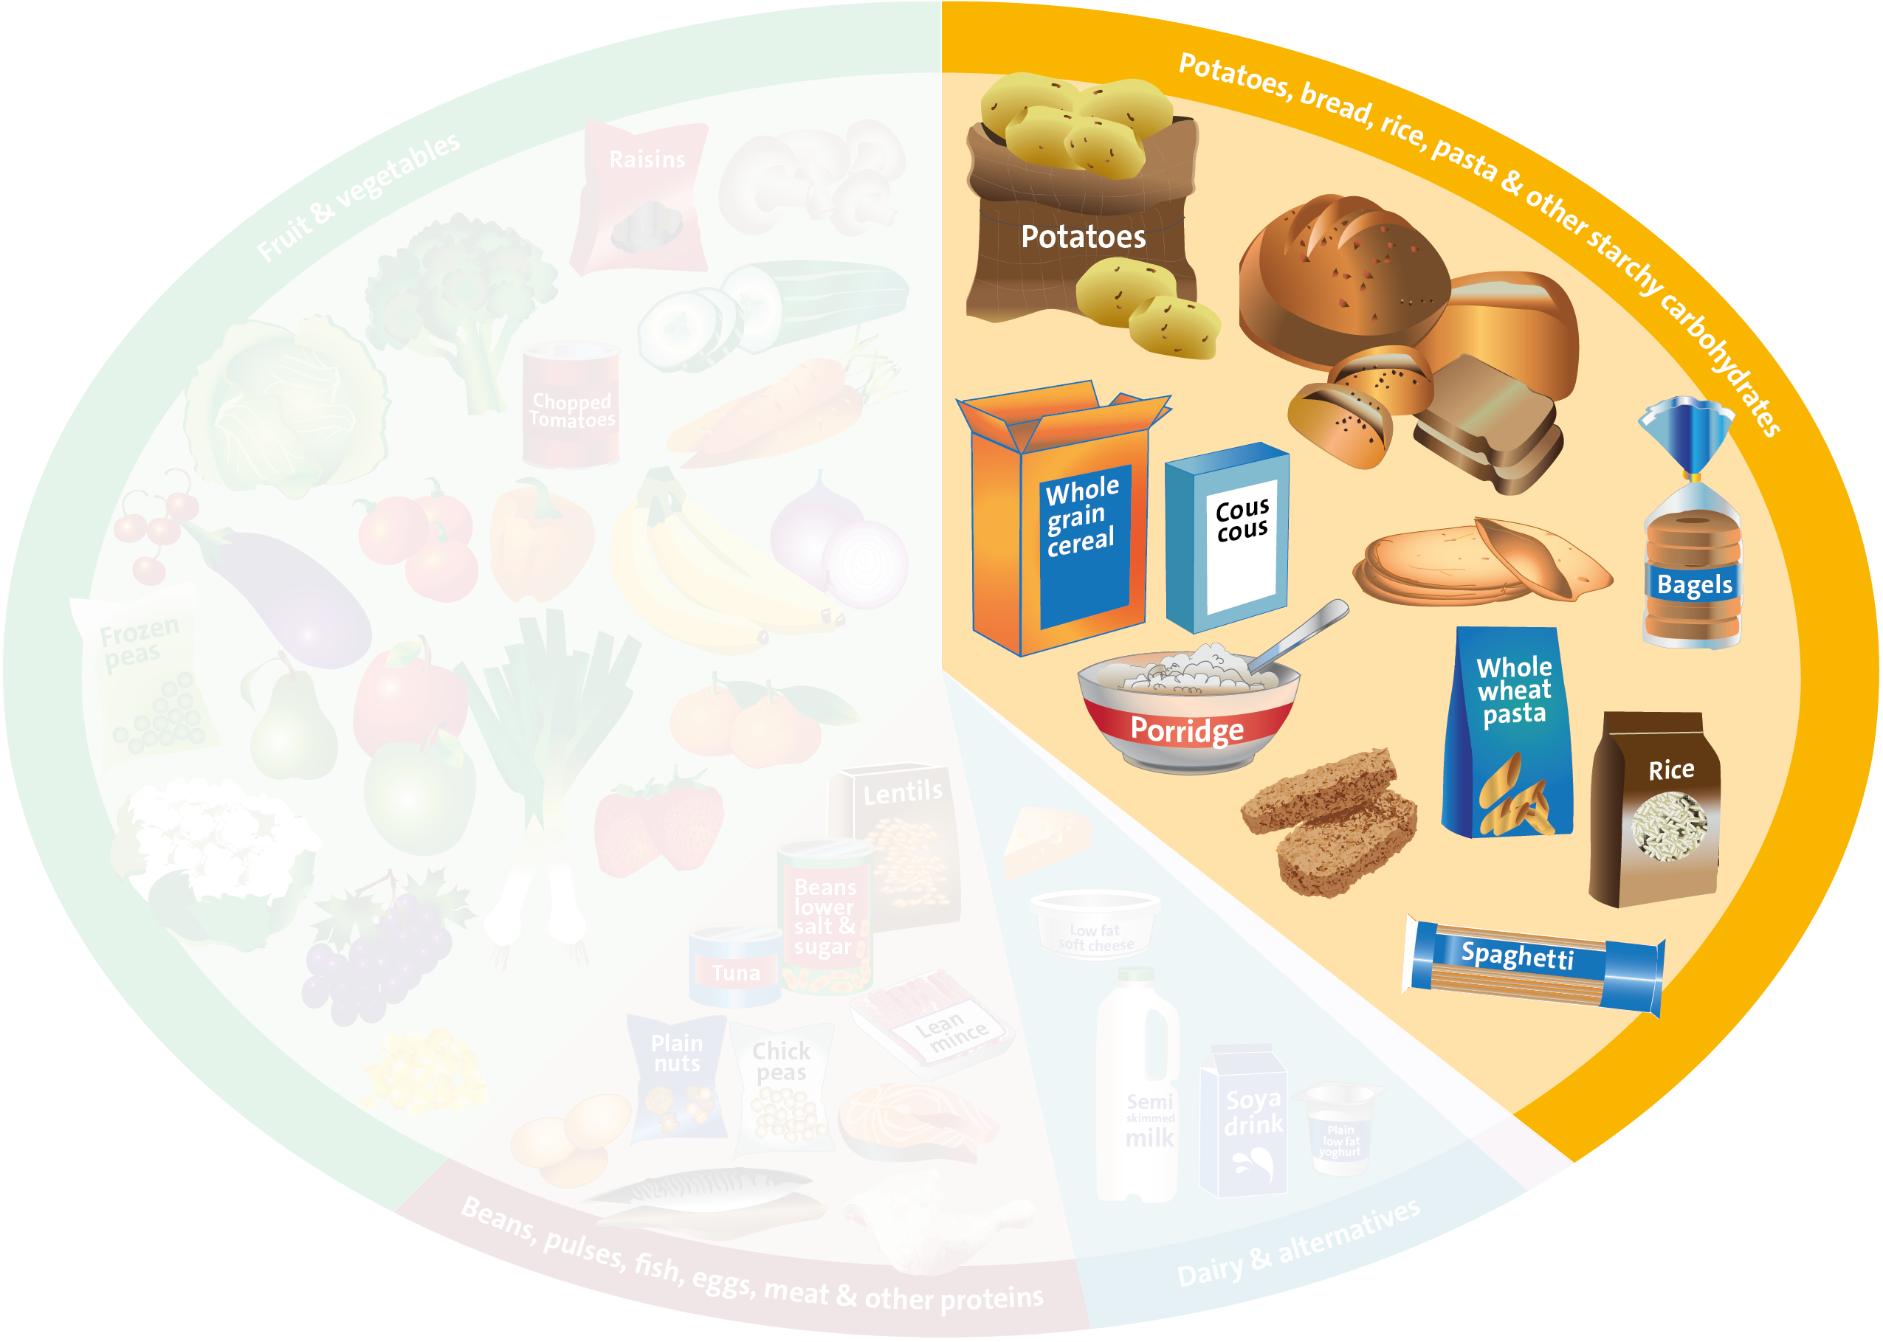

Carbohydrates
What is a portion size?

Slide 13
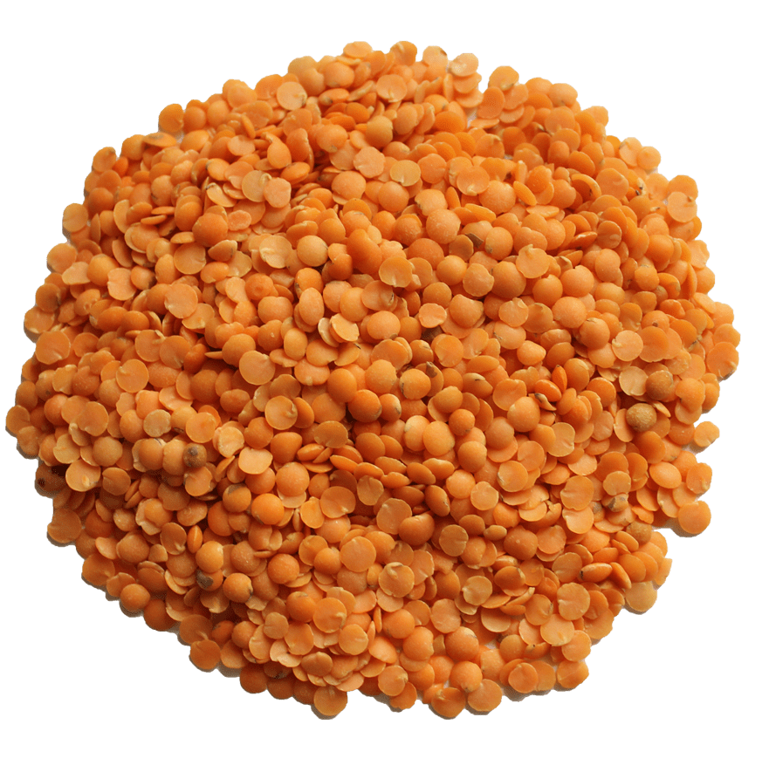
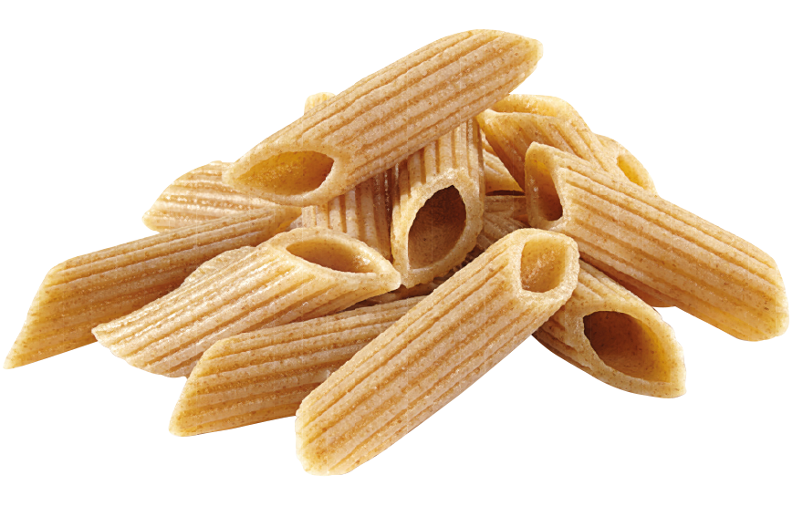
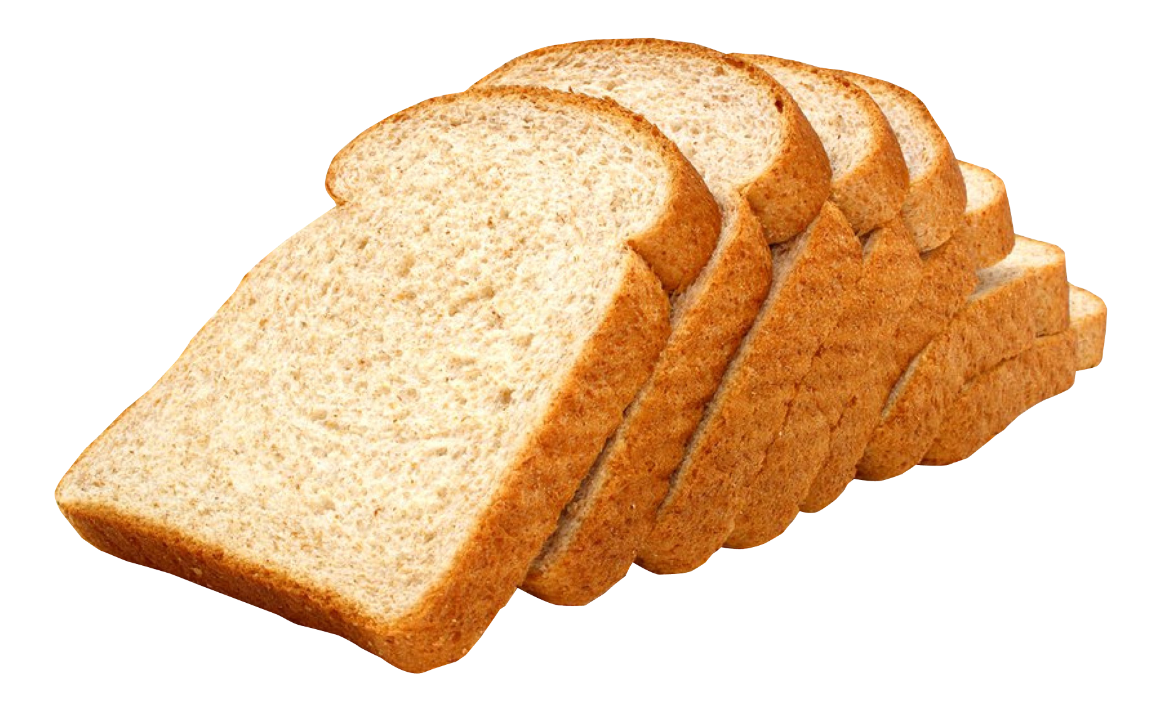
Carbohydrates
Which of our ingredients are Carbohydrates?
Which is the odd one out?
Pasta
Lentils
Bread

Slide 14
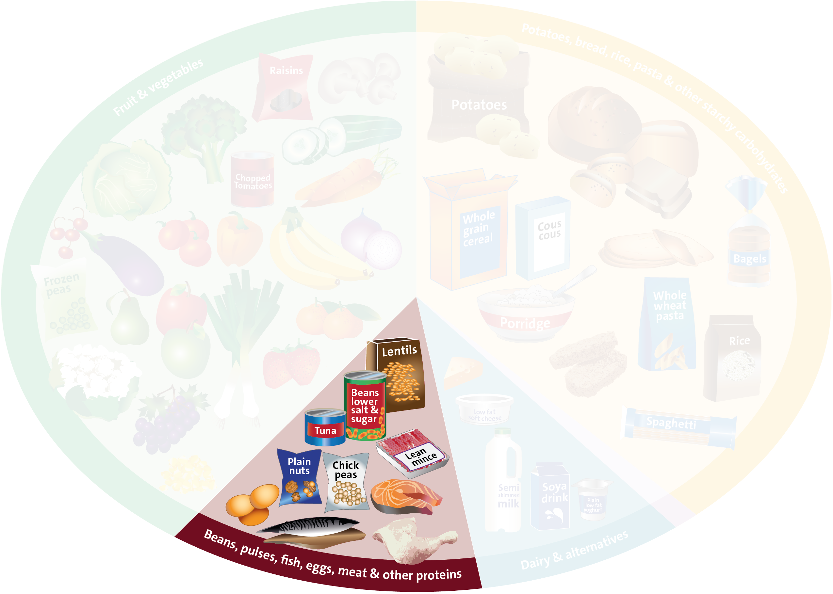




Protein
Plant
based protein
Animal
based protein
Notes:
Mention within protein category that we should try to eat fish twice a week with one being oily. Name oily fish, tuna, salmon, mackerel

Slide 15
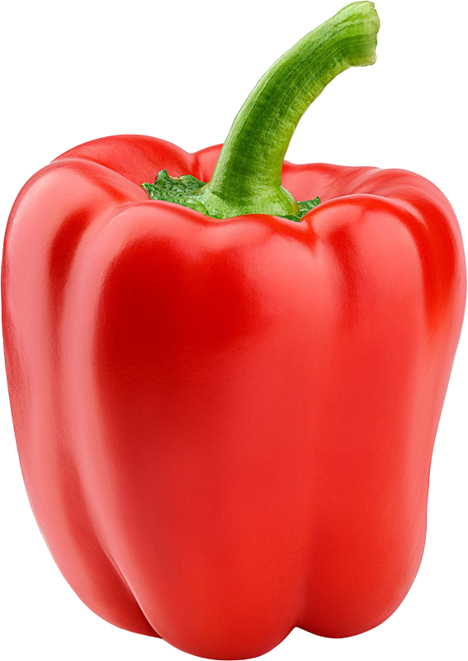
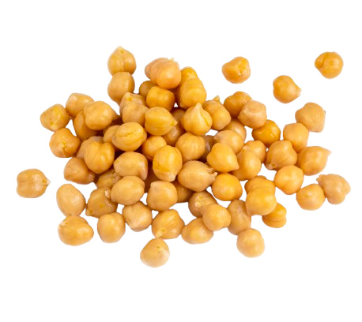
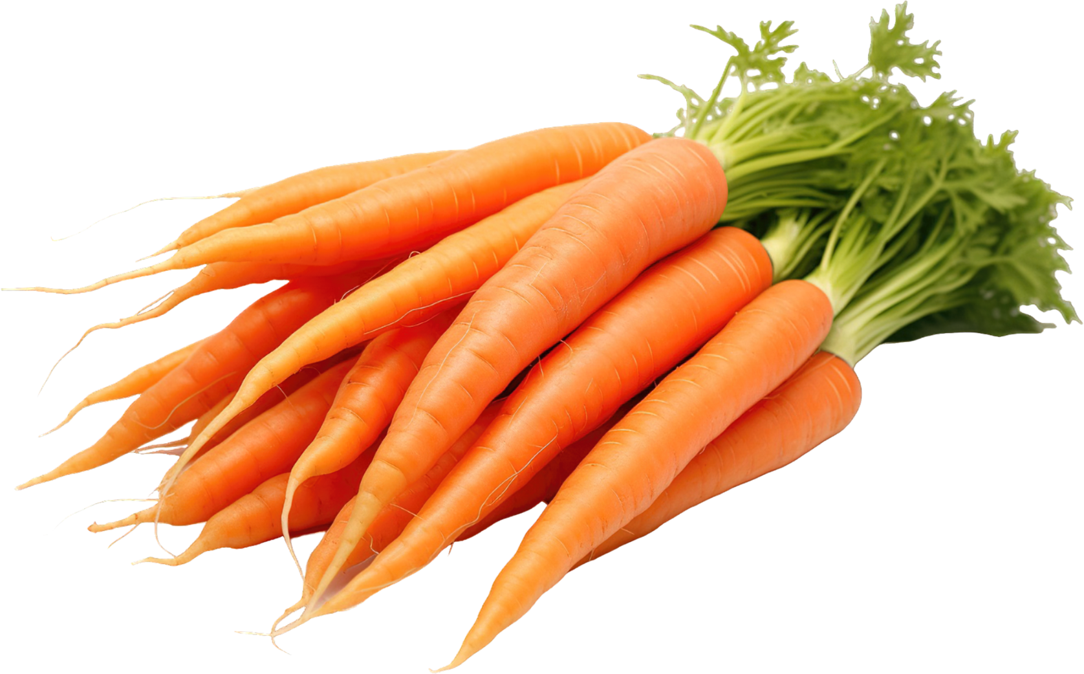
Protein
Which of our ingredients are protein?
Which of our ingredients are a source of protein?
Pepper
Carrots
Chickpeas
Notes:
Change beans to pepper- quinoa is high in protein

Slide 16
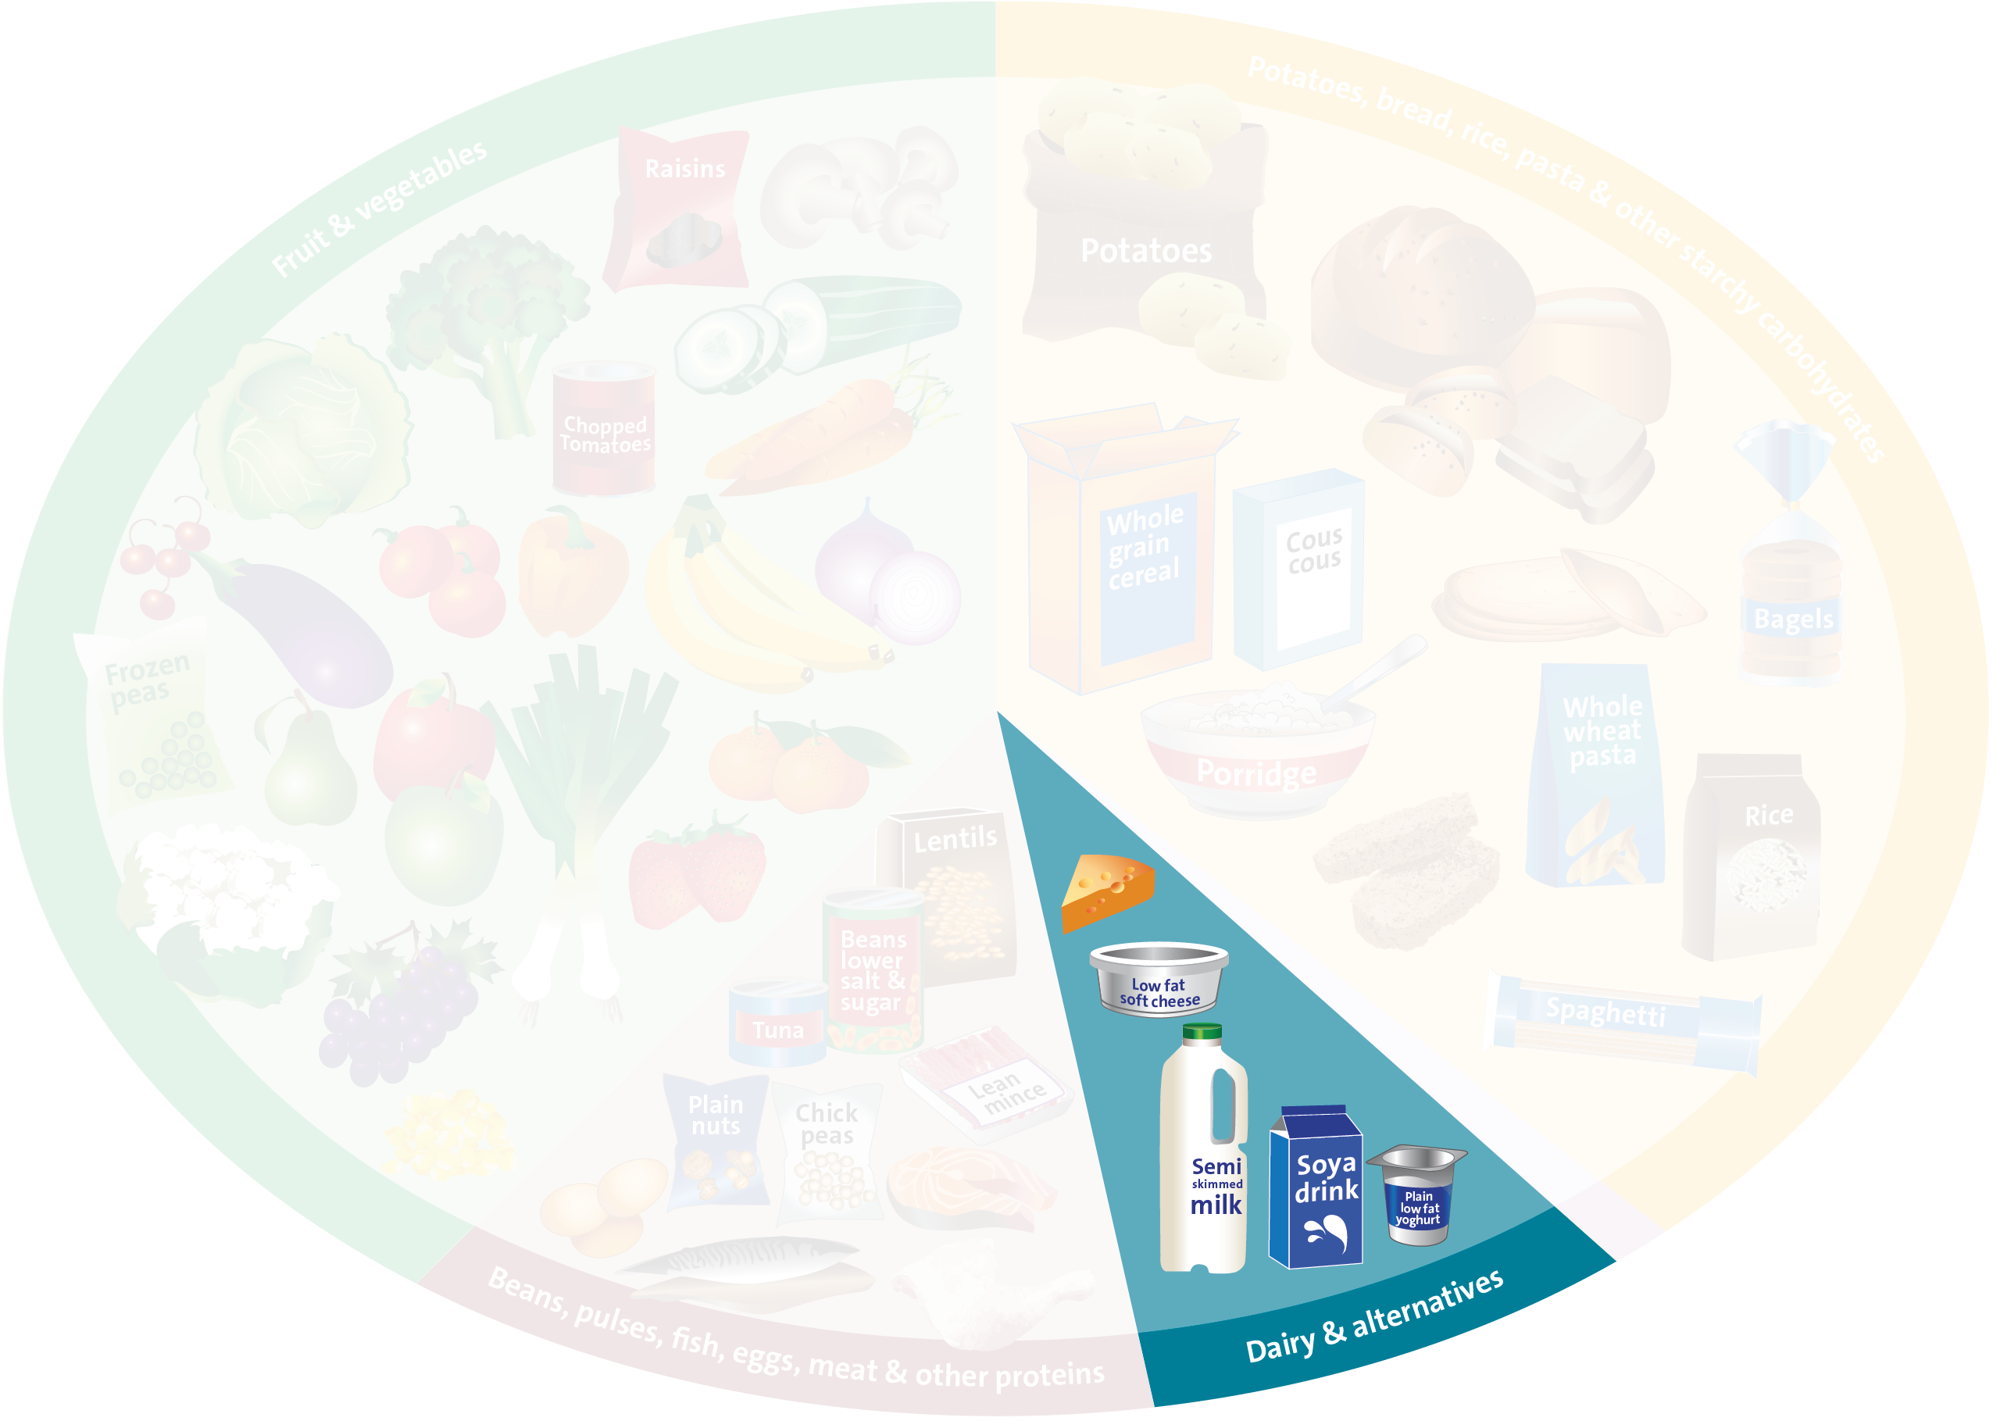


Dairy

Slide 17
Dairy
Which of our ingredients are dairy?
Notes:
Food produced from the milk of a mammal
Cows
Goats
Buffalo
Ewes etc

Slide 18
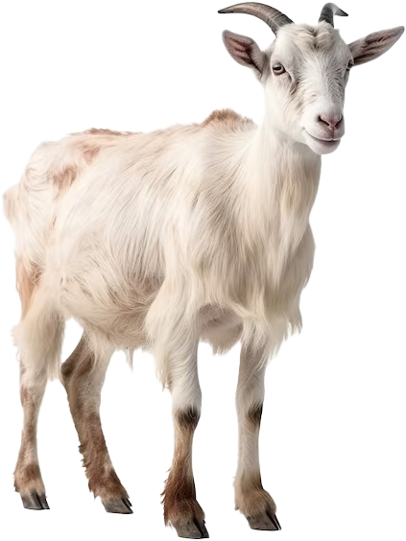

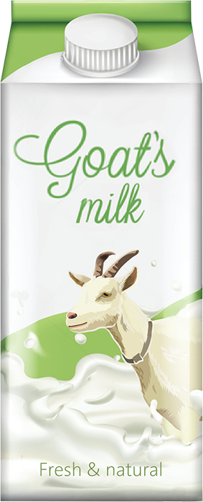
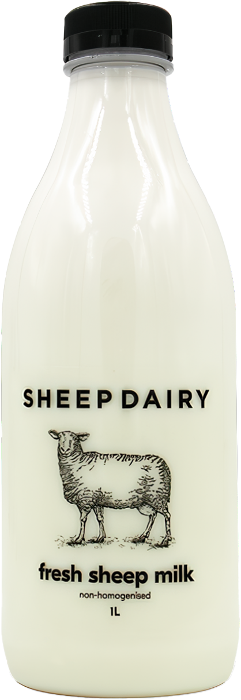

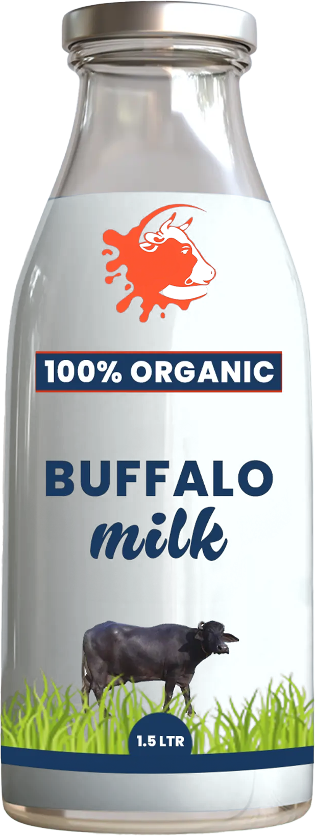

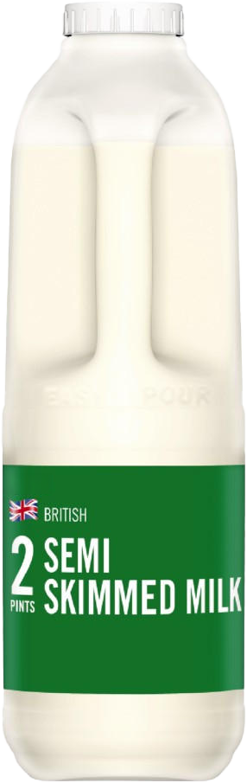
Dairy
Which of our ingredients are dairy?
Which milk product is from animals, and which is from plants?
Notes:
Food produced from the milk of a mammal
Cows
Goats
Buffalo
Ewes etc

Slide 19
Dairy
Which of our ingredients are dairy?
Which milk product is from animals, and which is from plants?
Notes:
Food produced from the milk of a mammal
Cows
Goats
Buffalo
Ewes etc

Slide 20
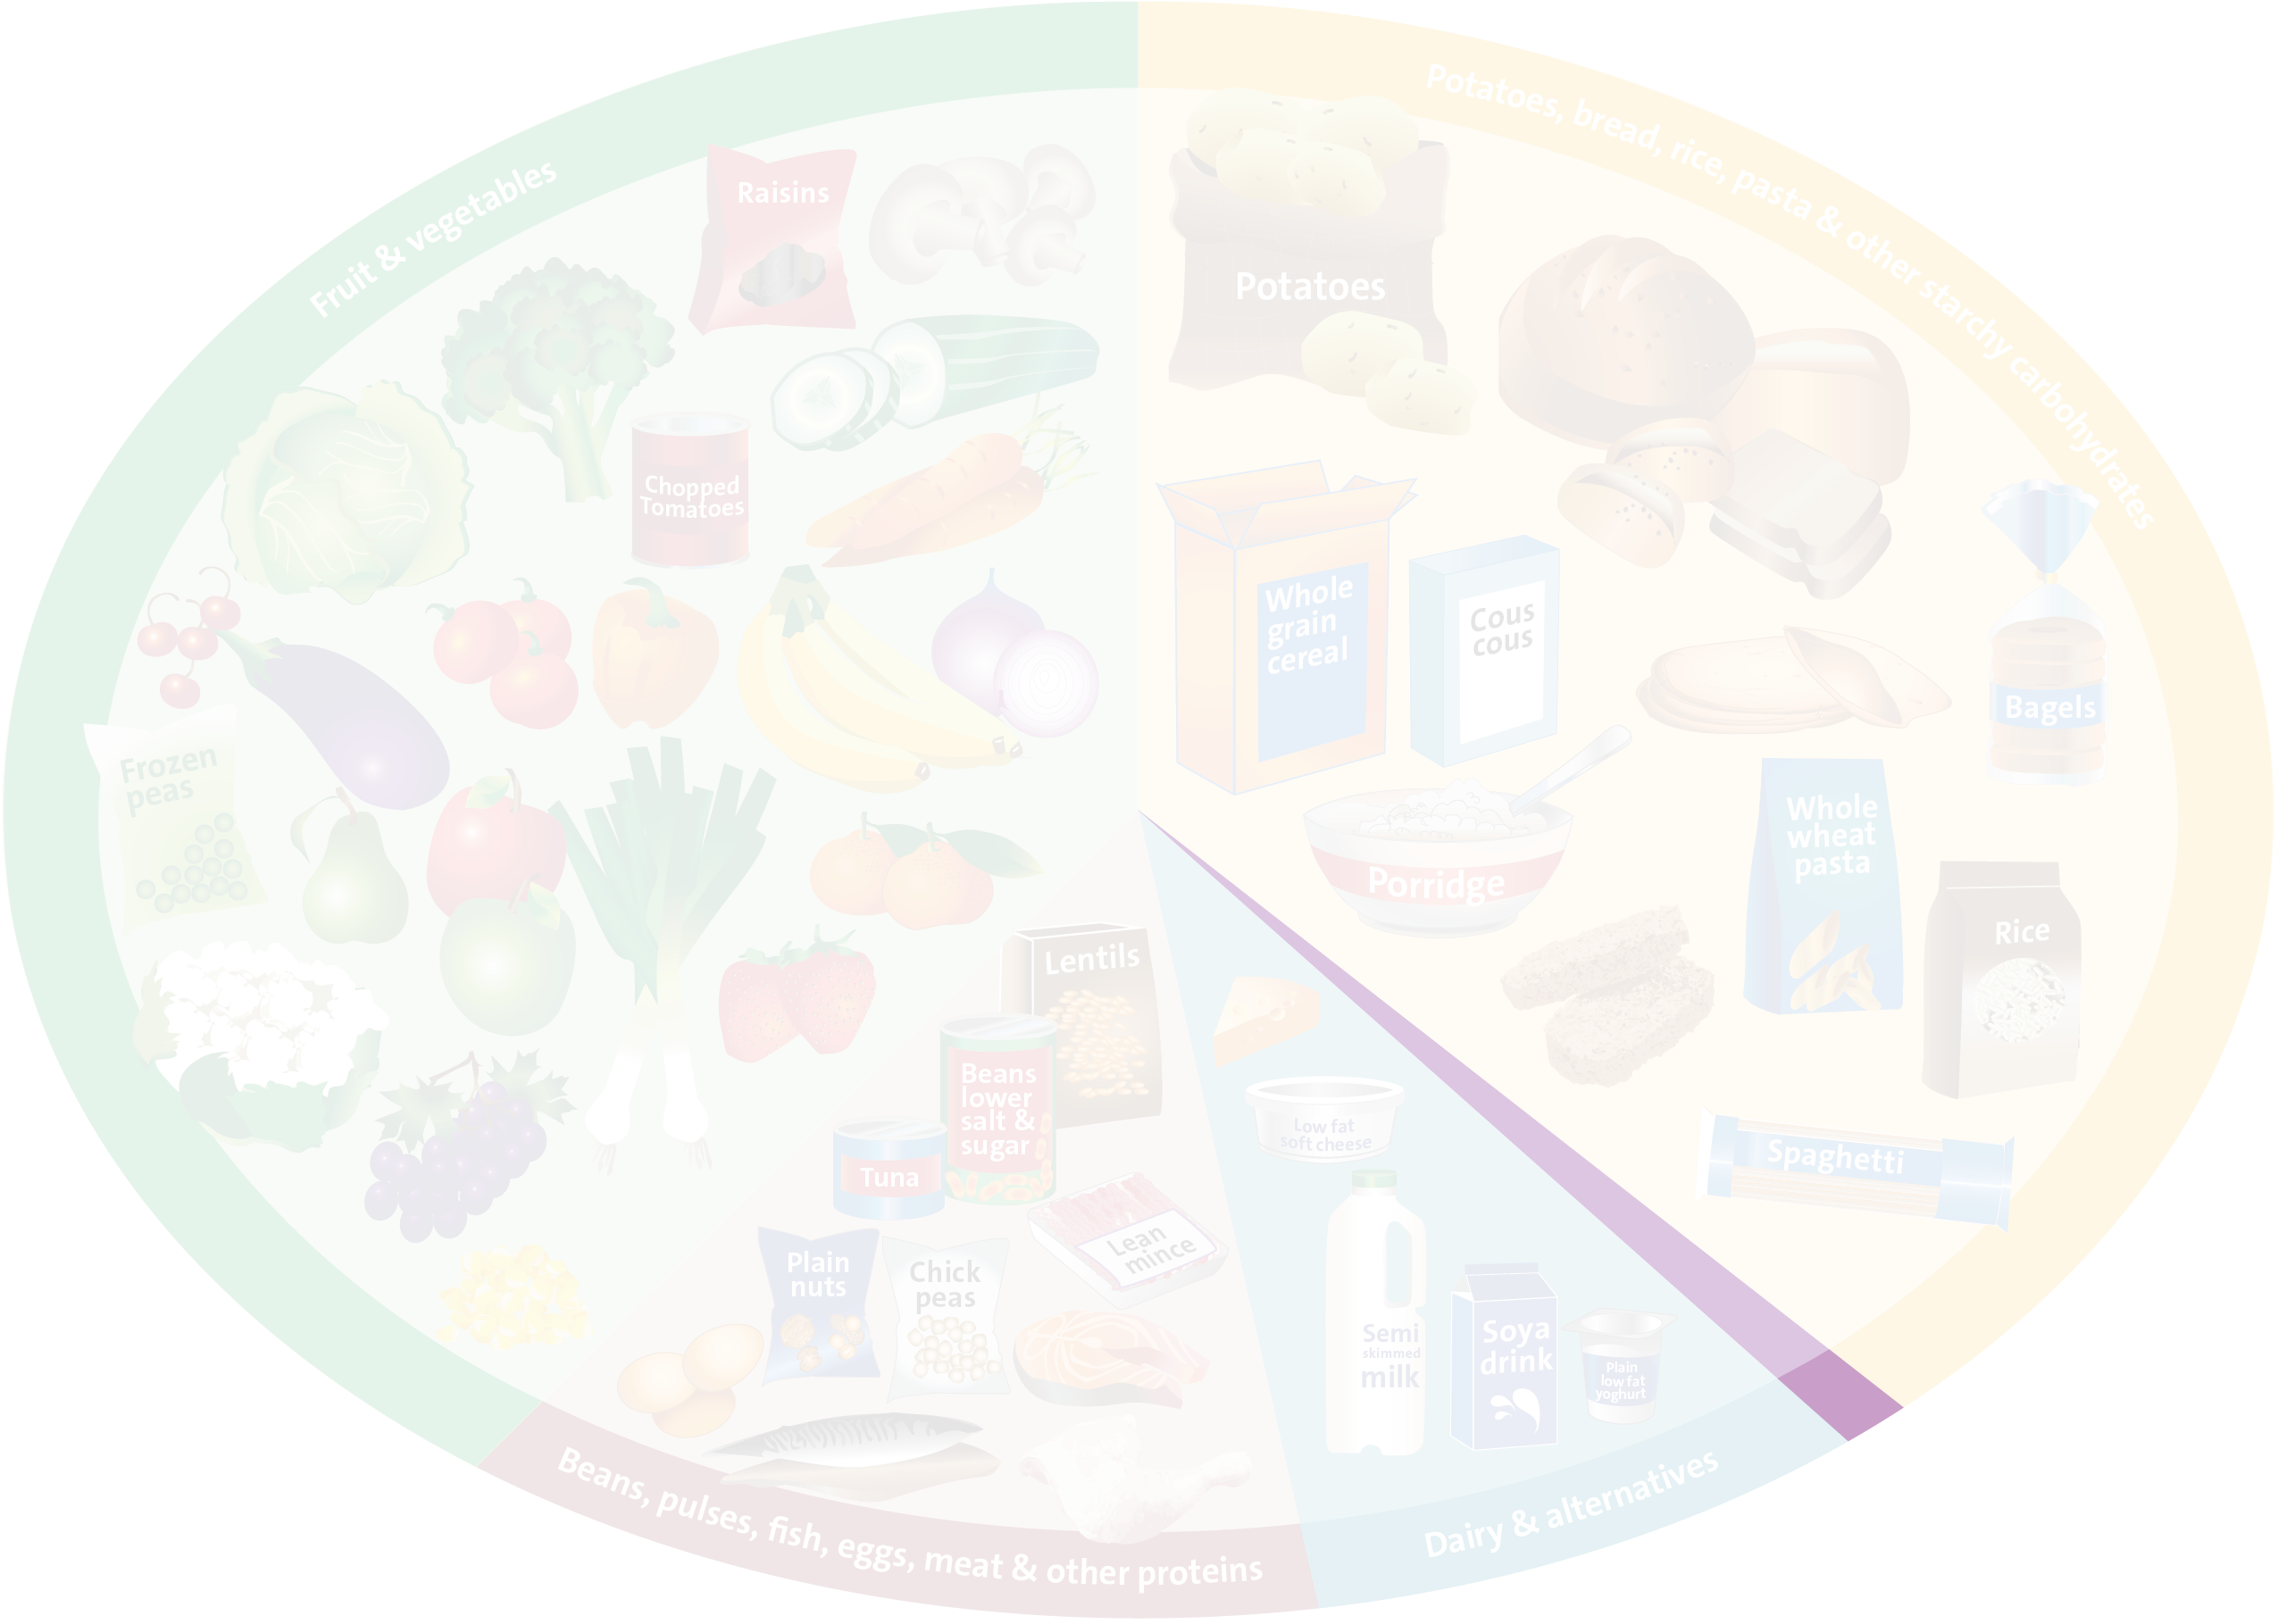



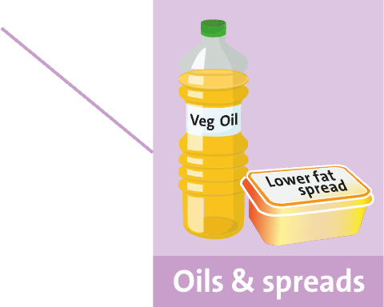
Oils & Spreads

Slide 21


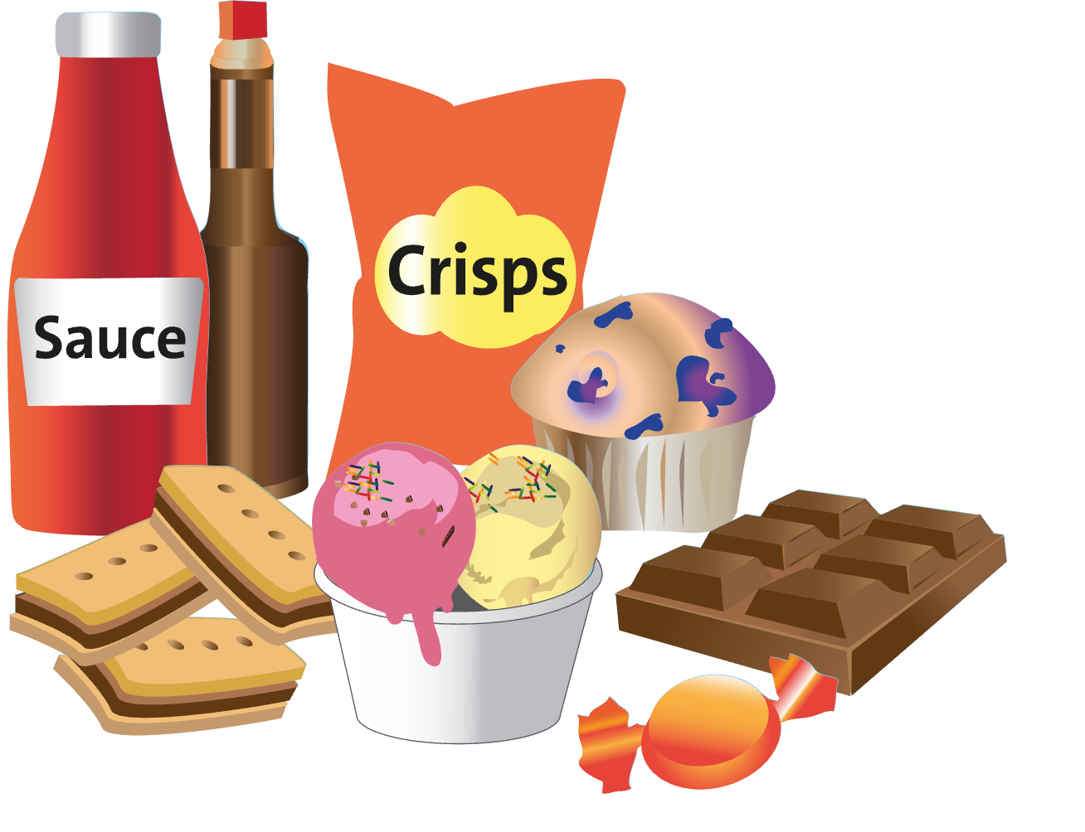

Food & Drinks High in Fat & Sugar
Hydration
Can you name some alternative healthy snacks?
Water is best
Provides energy that doesn't last and can make you hungry shortly after eating them

Slide 22

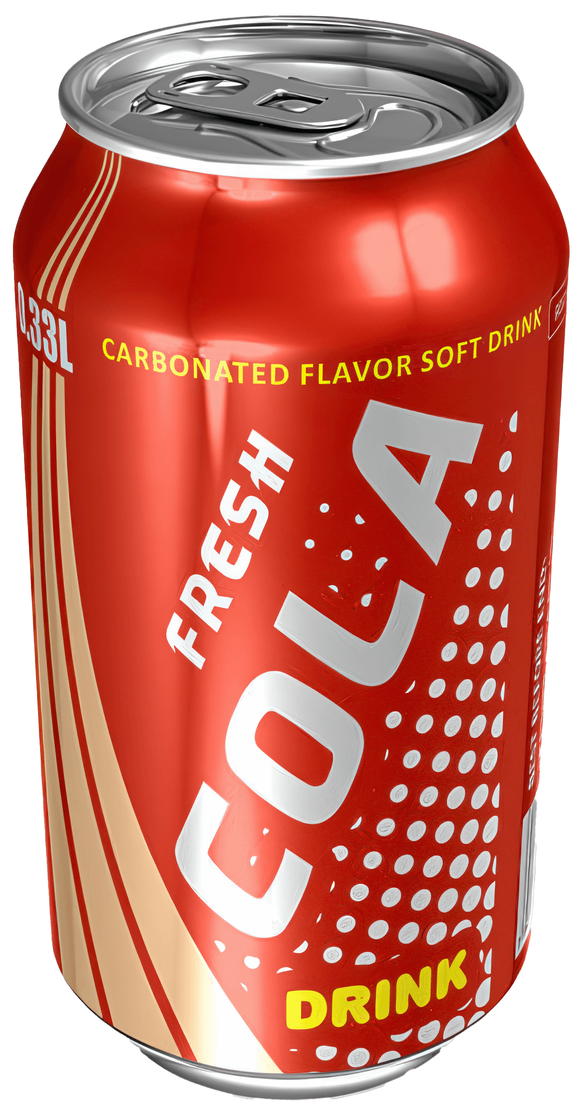
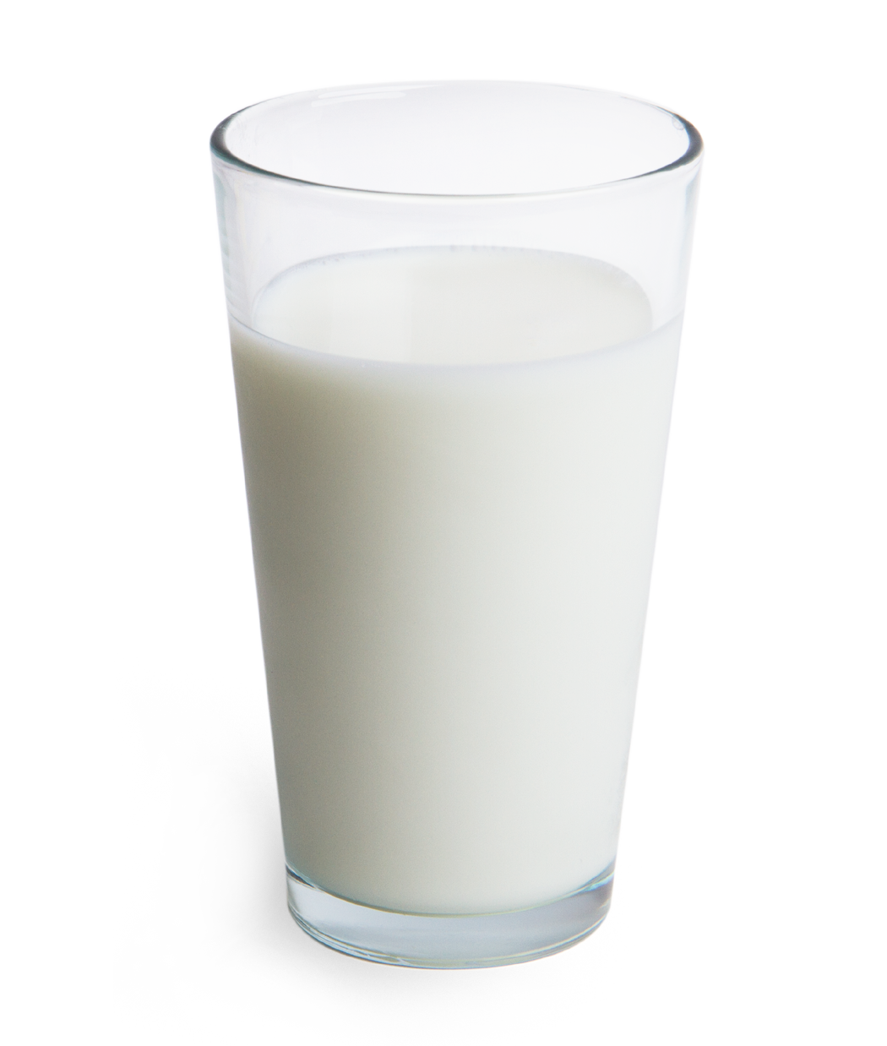
Food & Drinks High in Fat & Sugar
Hydration
Can you place these three drinks in order of sugar per glass from lowest to highest?
Can you name some alternative, healthy snacks?
Water is best
Provides energy that doesn't last and can make you hungry shortly after eating them
LOW
HIGH

Slide 23
Lesson Exercise
We Are Learning: About the 5 main food groups
Section your plate to reflect the 5 main food groups
Label each section
Write down 3-5 foods in each food groups
What is each food group required to do in the body?
Notes:
Section your plate to reflect the 5 main food groups (Fruits & Vegetables, Carbohydrates, Protein, Dairy & Fats).
Label each section
Write down 3-5 foods in each of those food groups
What is each food group required to do in the body?

Slide 24

Plenary

Slide 25

Summary
… children will be able to name the 5 main groups of the Eatwell Guide
… children will be able to put different foods into the main groups
… children will be able to name what each food group is required for in the body
Notes:
Do we need LO?

Slide 26
Thank You

