Slide 1
Culinary Skills Training
Garnish & Plate Presentation

Slide 2
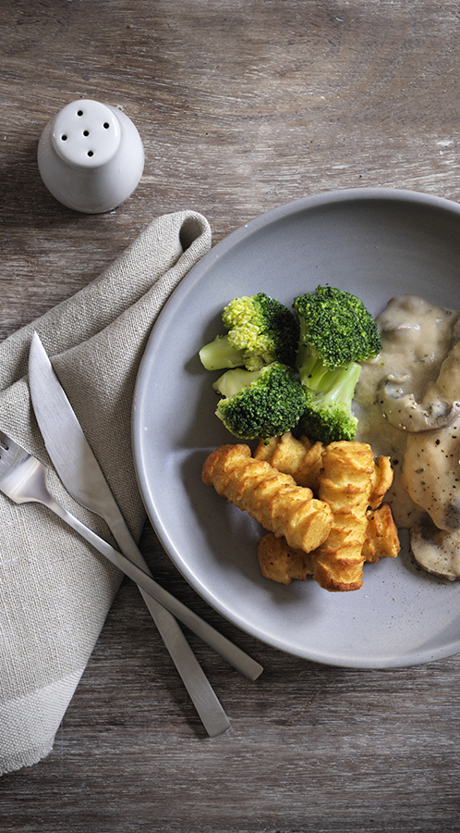
Contents
1.
Basic Kitchen Rules
Hand washing and general hygiene before entering the kitchen
2.
Knife Safety
The uses of different knives and how to use them safely
3.
Useful Garnishes
Garnishes that we recommend using
4.
Plate Presentation
Do’s and Don’ts of plate presentation
5.
Suitable Garnishes for Ceramic Service
What garnishes to use for ceramic service
6.
Garnishing examples
What does a good garnish look like?

Slide 3
General Rules Before Entering a Kitchen

Slide 4
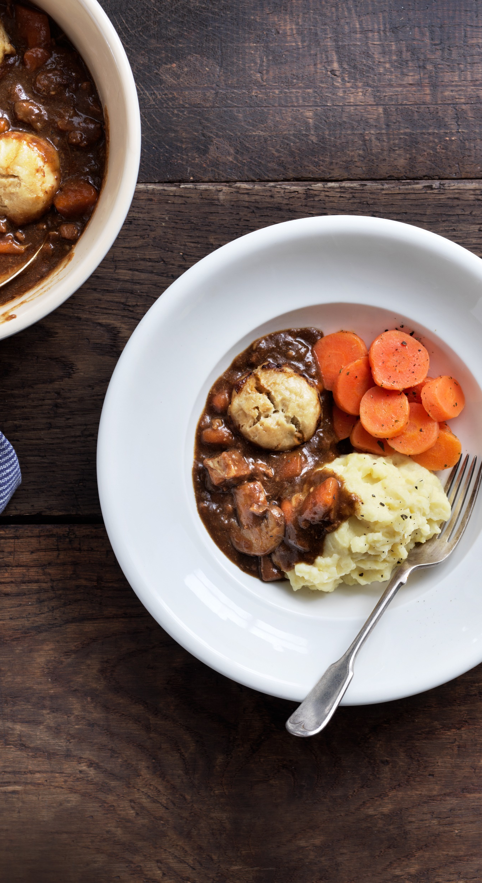
Handwashing & General Rules
  When should you wash your hands?
  Protective Clothing
  Footwear
  Hair & Nails
  HACCP/ Safer Food Better Business

Slide 5
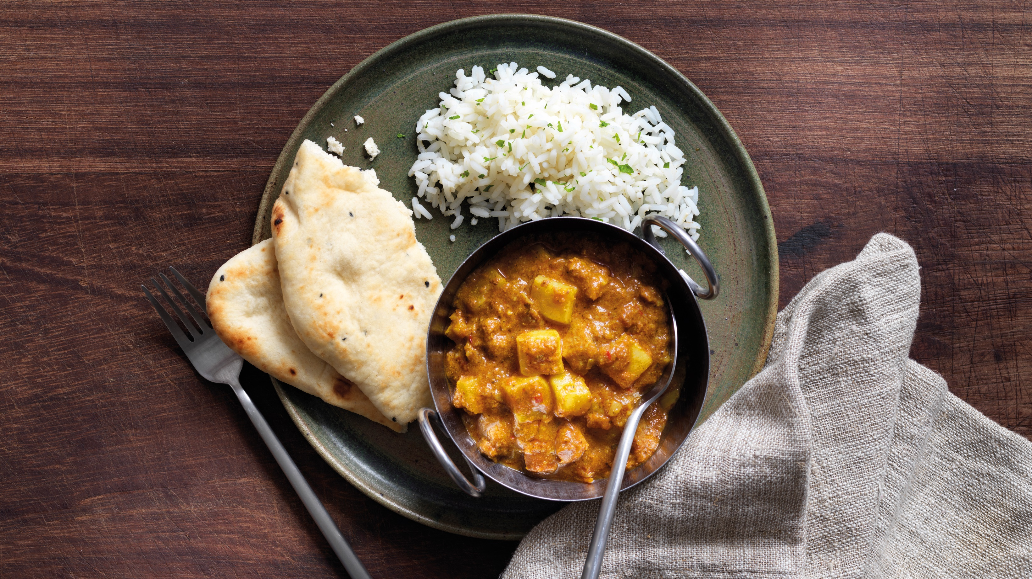

Knife Safety
The uses of different knives and how to use them safely

Slide 6
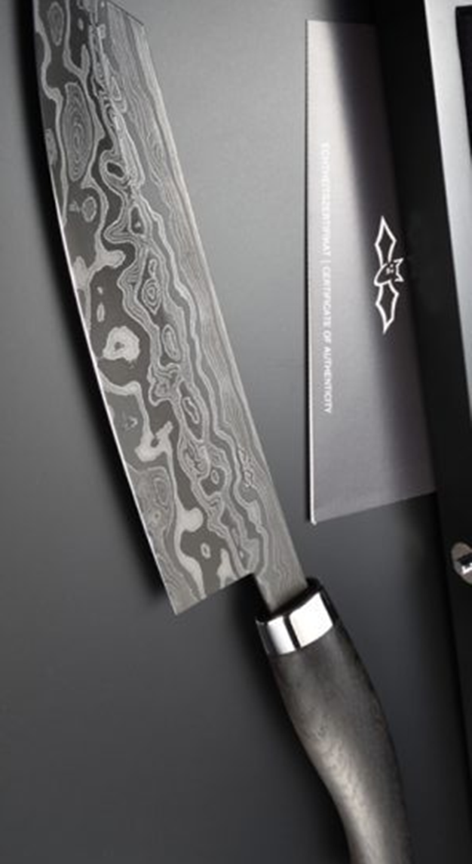
Ten Tips for Knife Safety
  Keep your knives sharp
  When chopping use your other hand as a guide
  Use kitchen knives for there intended purpose
  Use individual knives for their intended job
  Clean knives between tasks
  Always use a chopping boar
  Hand-wash your knives and dry thoroughly
  Store Knives Safely
  Don’t try and catch a falling knife
  Always hold a knife be its handle
Jahrhundert Messer
$100,000
by Nesmuk

Slide 7
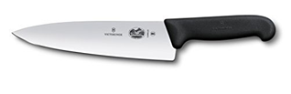
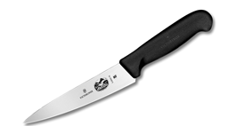
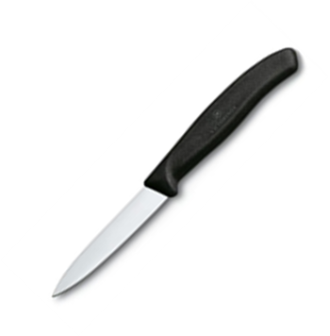
Know your knives!
  Chef’s Knife (Chopping Knife or Cook’s Knife)
  Typically 8-14 inches long, this all-purpose knife is used for chopping and slicing.
  Utility Knife
  Typically 5-7 inches long, it is a smaller, lighter version of the chef’s knife. It may be used as a chef’s knife on smaller items or as a pairing knife on larger items.
  Paring Knife
  Typically 3-4 inches long, a paring knife works more as an extension of your hand and used for paring and trimming fruits and vegetables.

Slide 8
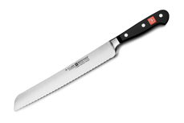
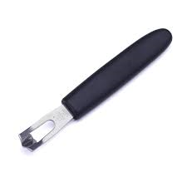
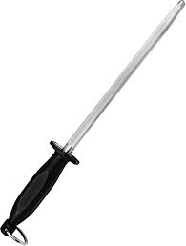
Know your knives!
  Serrated Knife
  Typically up to 8-12 inches long, it is also referred to as a bread knife, as the serrated blade is perfect for cutting breads, cakes and pastries.
  Canelle Knife
  This is used for cutting grooves or channels into the skin of fruits and vegetables. This can give interesting results when used in garnish preparation.
  Steel
  Also called a honing steel, this id used to sharpen knives on a regular basis, often between tasks. However, periodically knives will also need sharpening on a grinding stone.

Slide 9

Useful Garnishes
Garnishes we recommend using

Slide 10
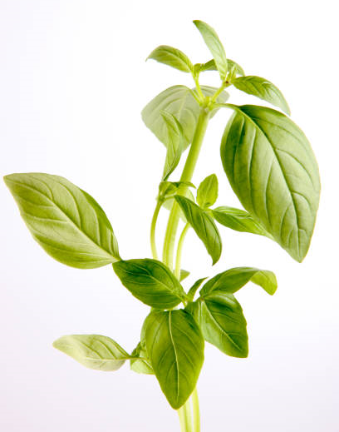
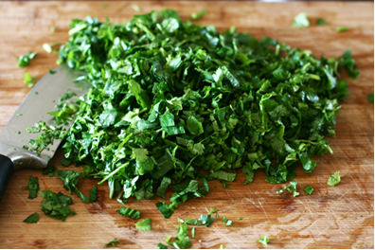
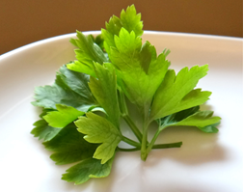
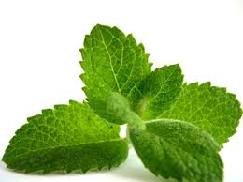
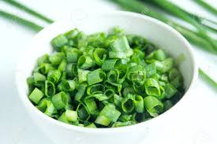
Herb Garnish

Slide 11
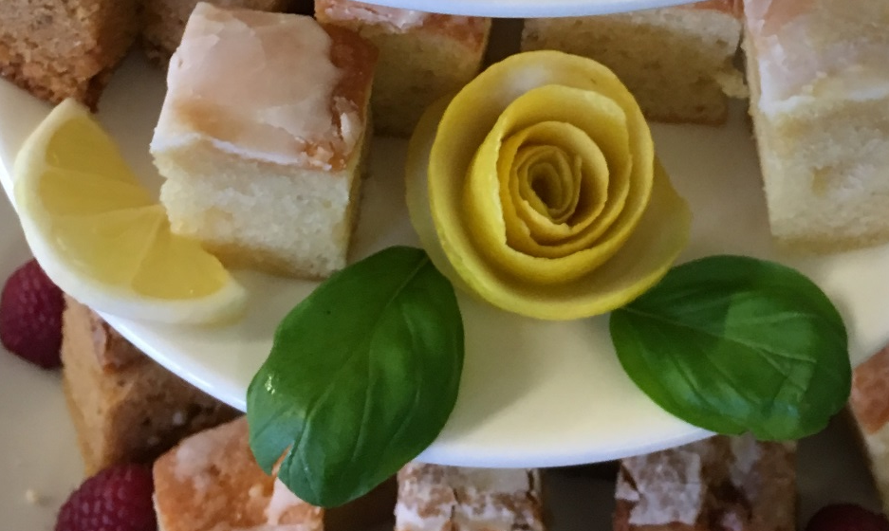
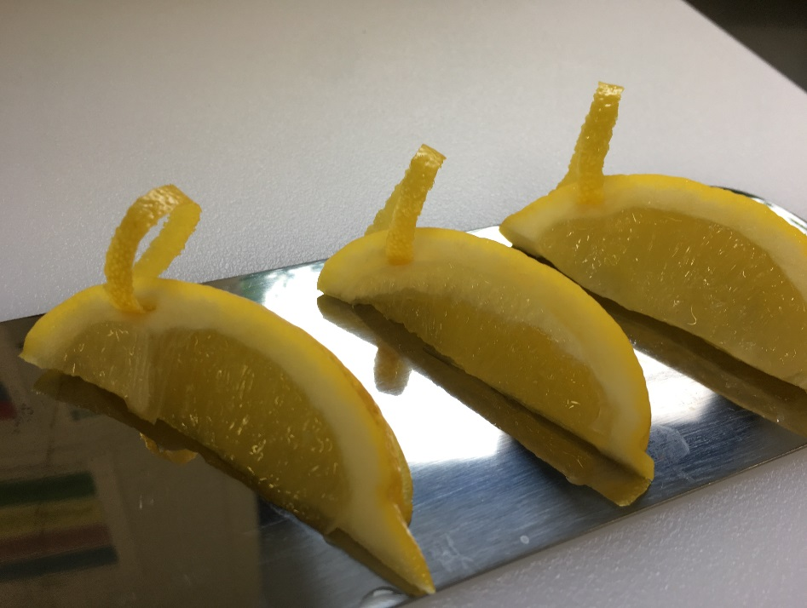
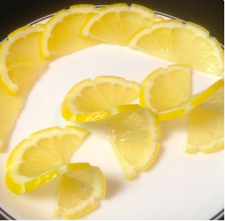
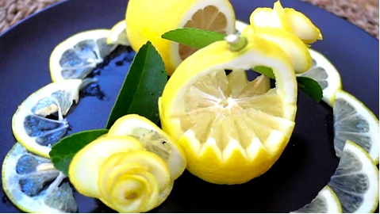
Lemon Garnish

Slide 12
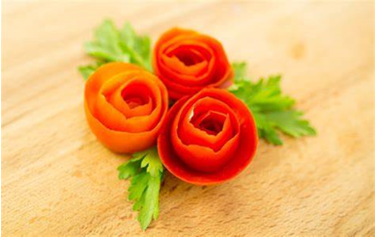
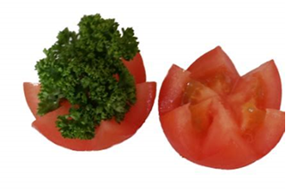
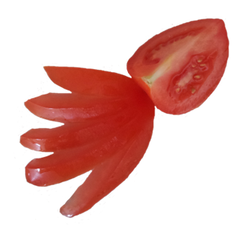
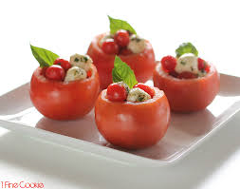
Tomato Garnish

Slide 13
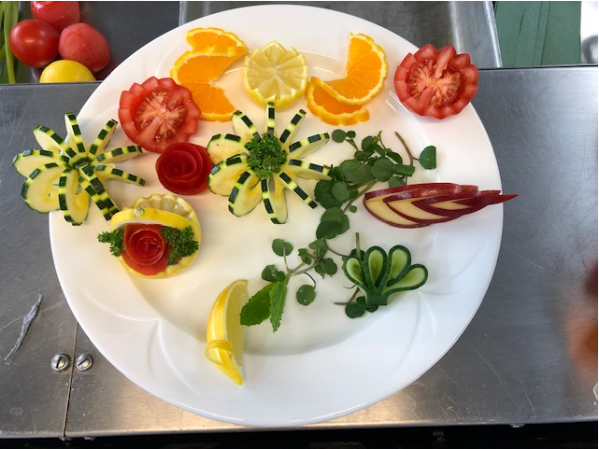
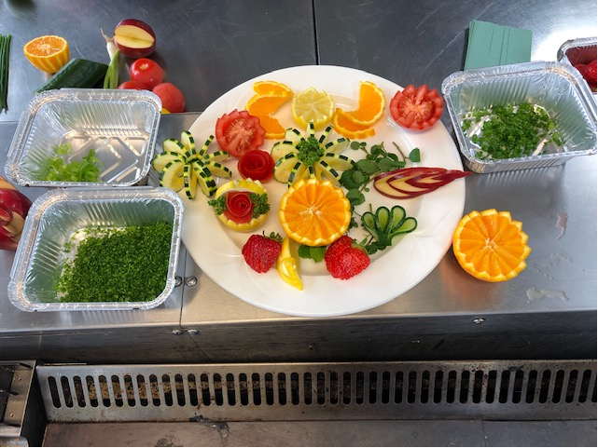
Garnish Prep Plate

Slide 14
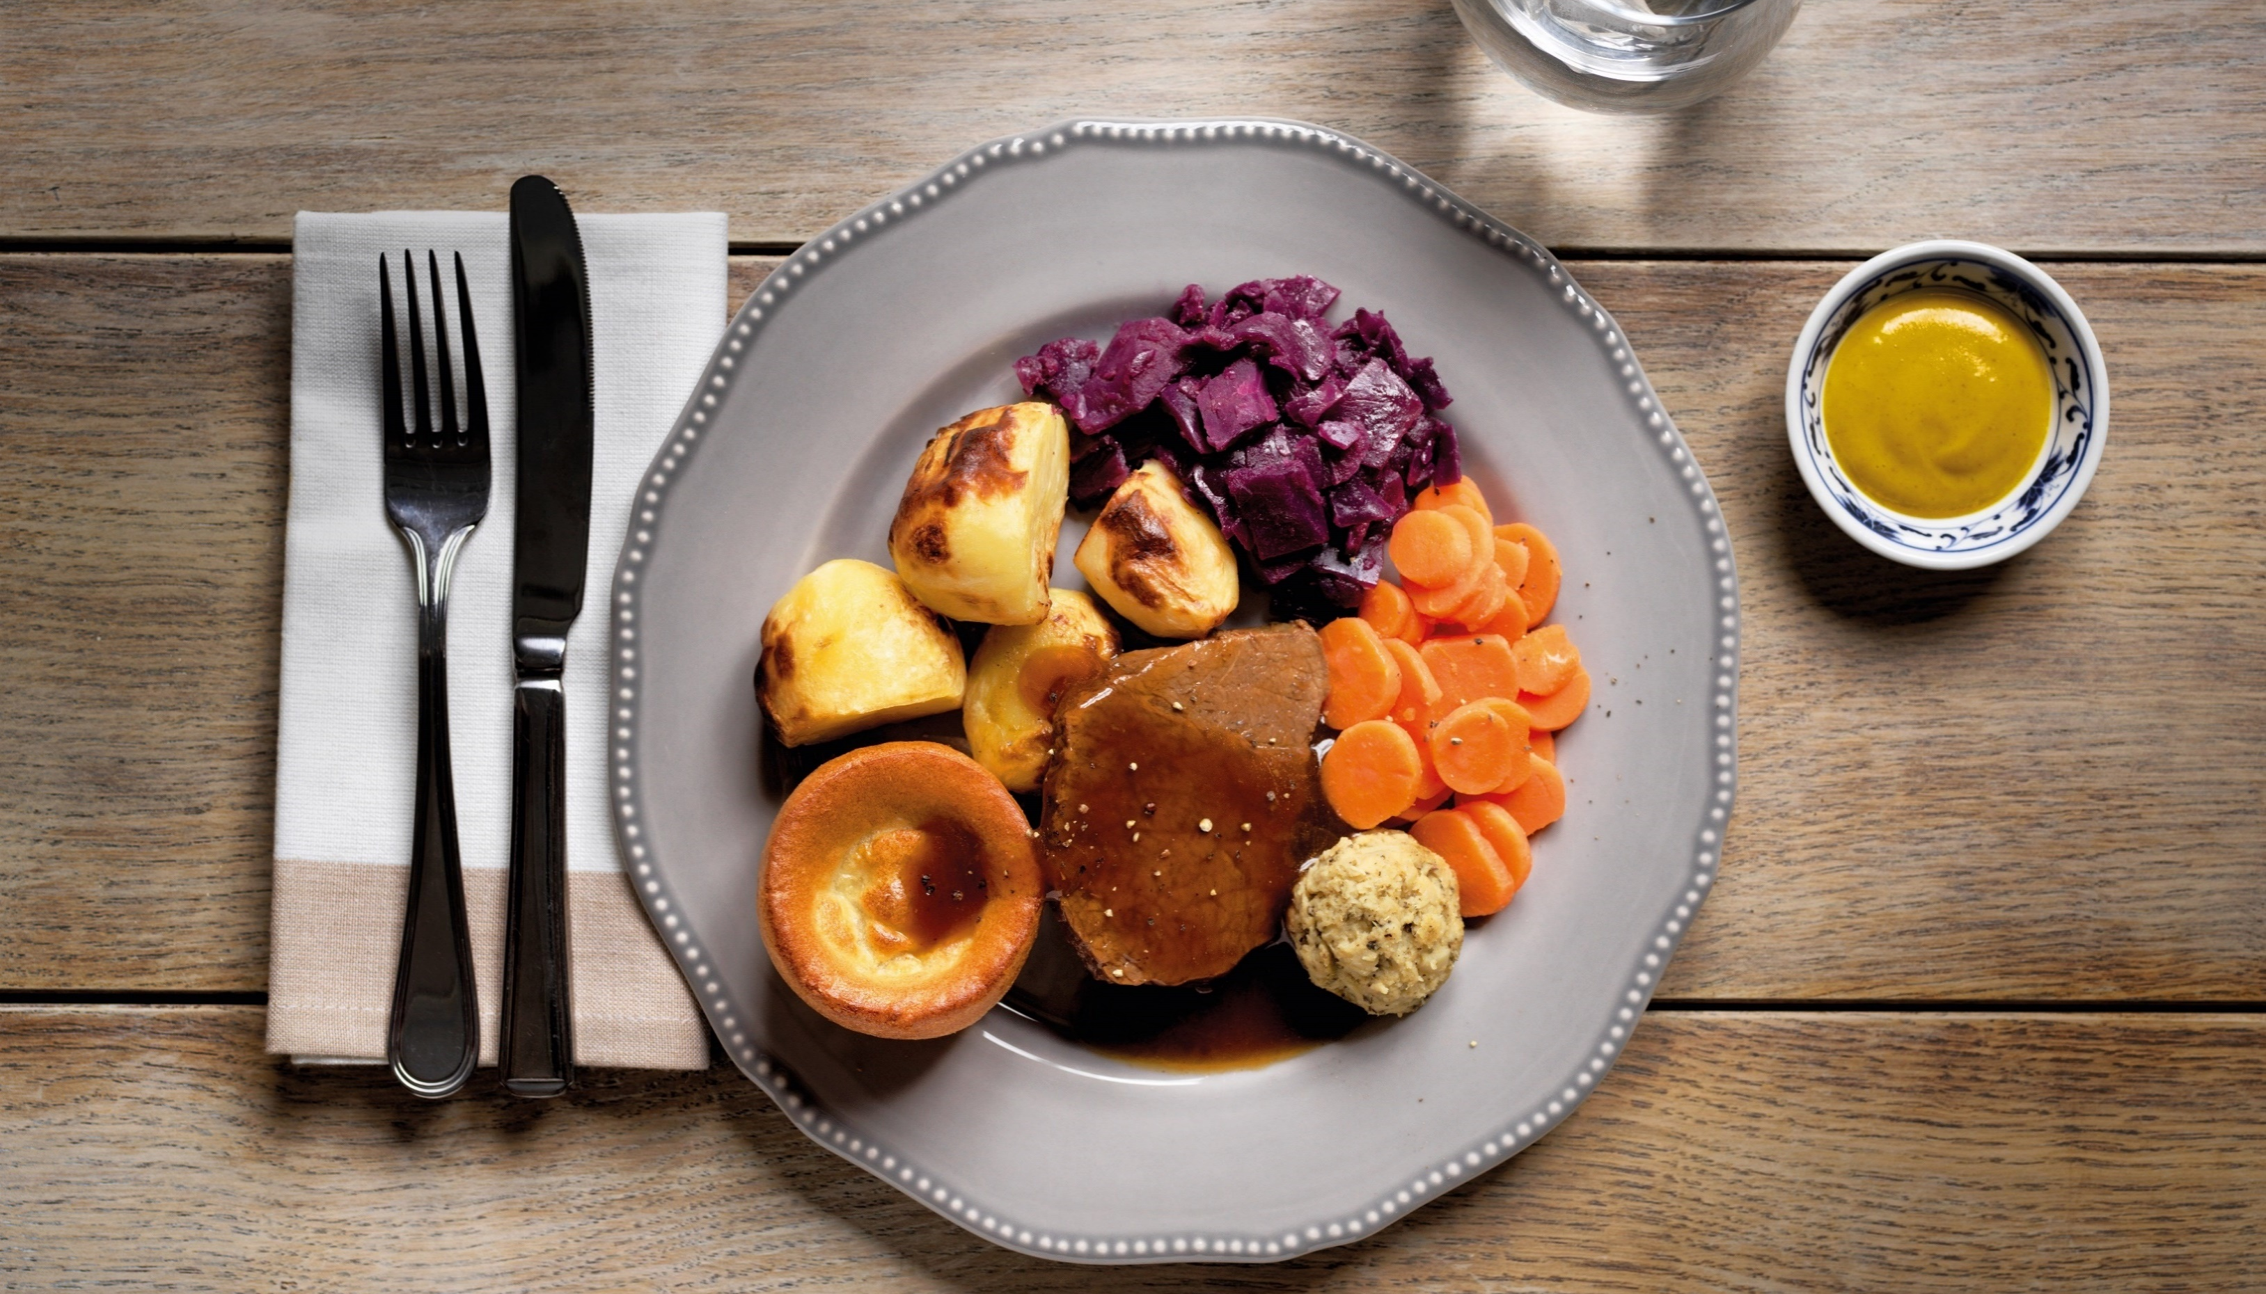
Plate Presentation

Slide 15

Plate Presentation
  Choose the perfect plate (size and colour)
  Placing your ingredients
  Use moist ingredients as your base
  Serve odd amounts of food
  Don’t overcrowd your plate
  Think about colour and contrast
  Create height on your plate
  Contrasting textures
  Use sauces as part of the design
  Choose the right garnish

Slide 16
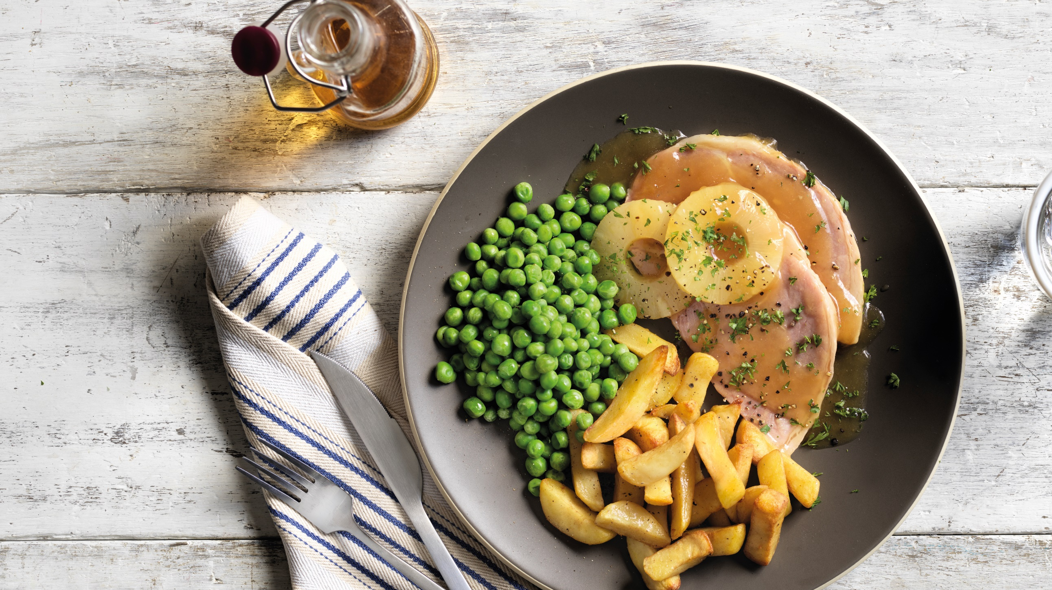
Service Presentation

Slide 17
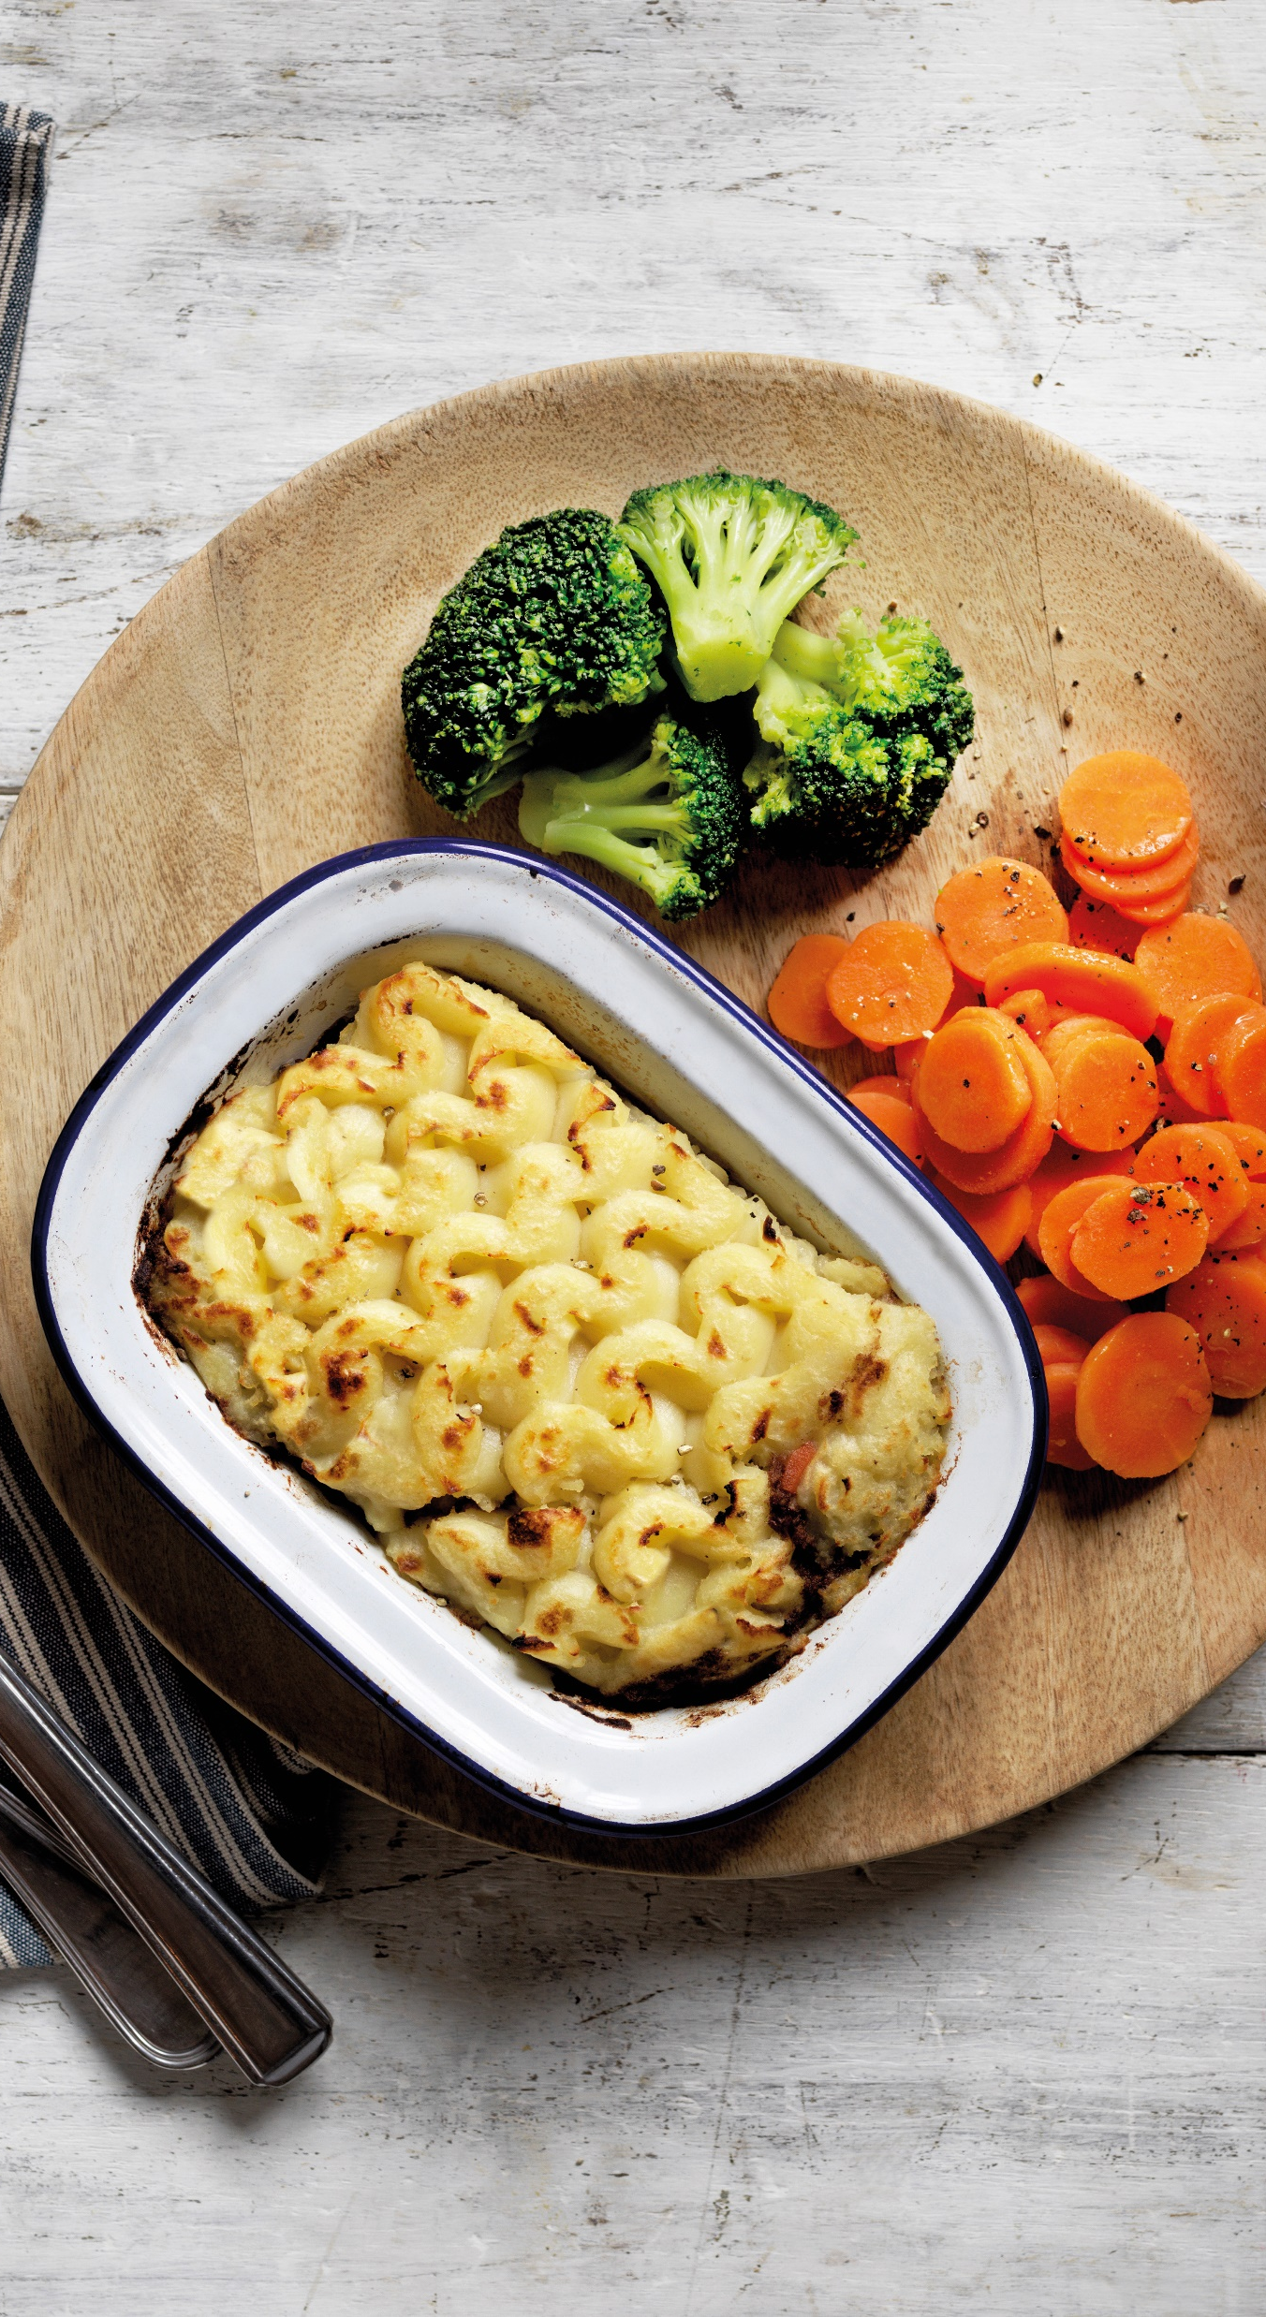
Ceramic Garnish Ideas
What garnish do we need?
  Lemons/Limes
  Red Onion
  Tomatoes
  Herbs
    Parsley – Sprigs and finely chopped
    Coriander – Sprigs and chopped
    Chives - Chopped
    Rosemary - Sprigs
    Mint – Leaves and tips
    Thyme – Sprigs

Slide 18
Garnishing Examples
What does a good garnish look like?

Slide 19
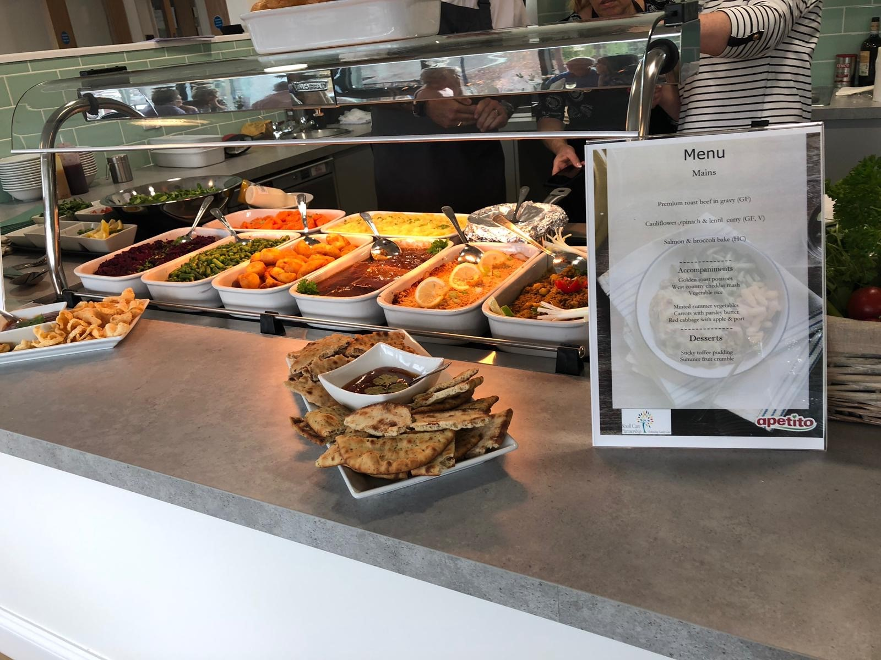
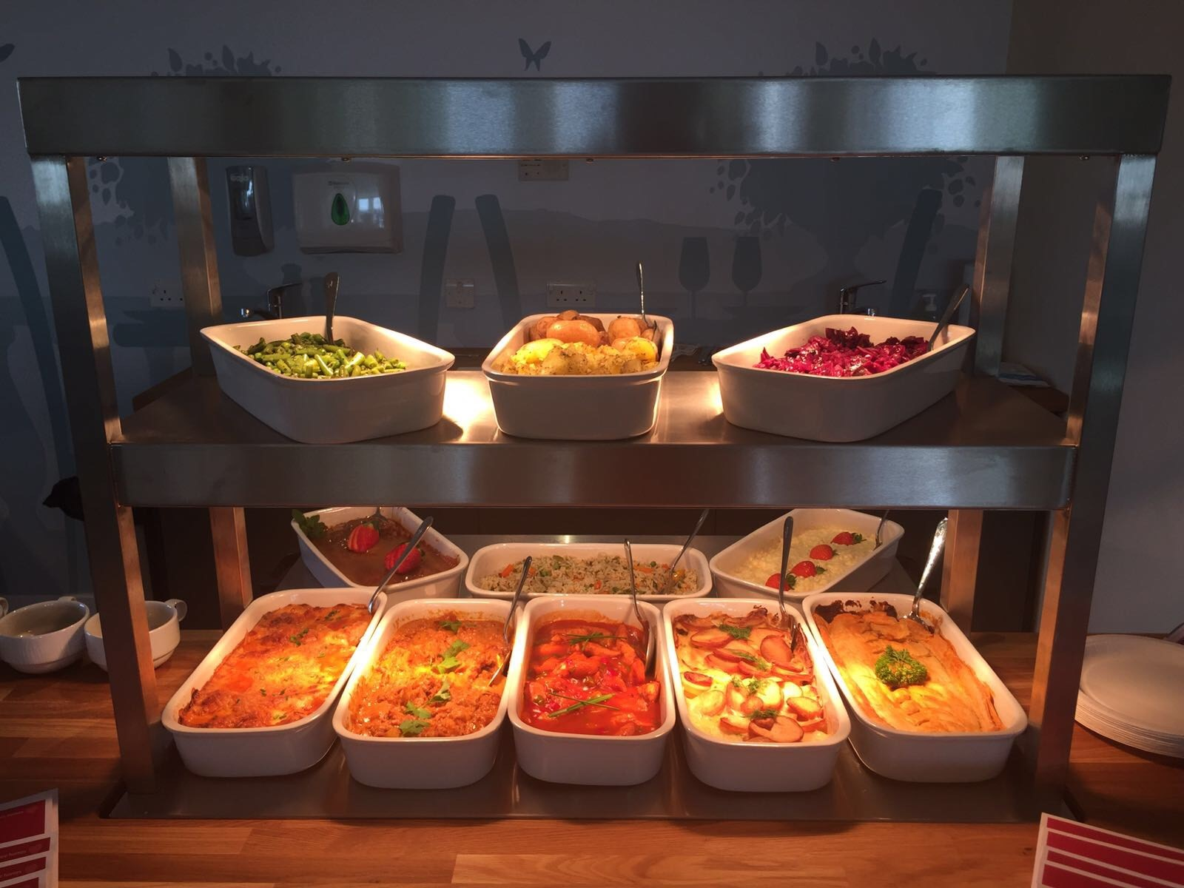
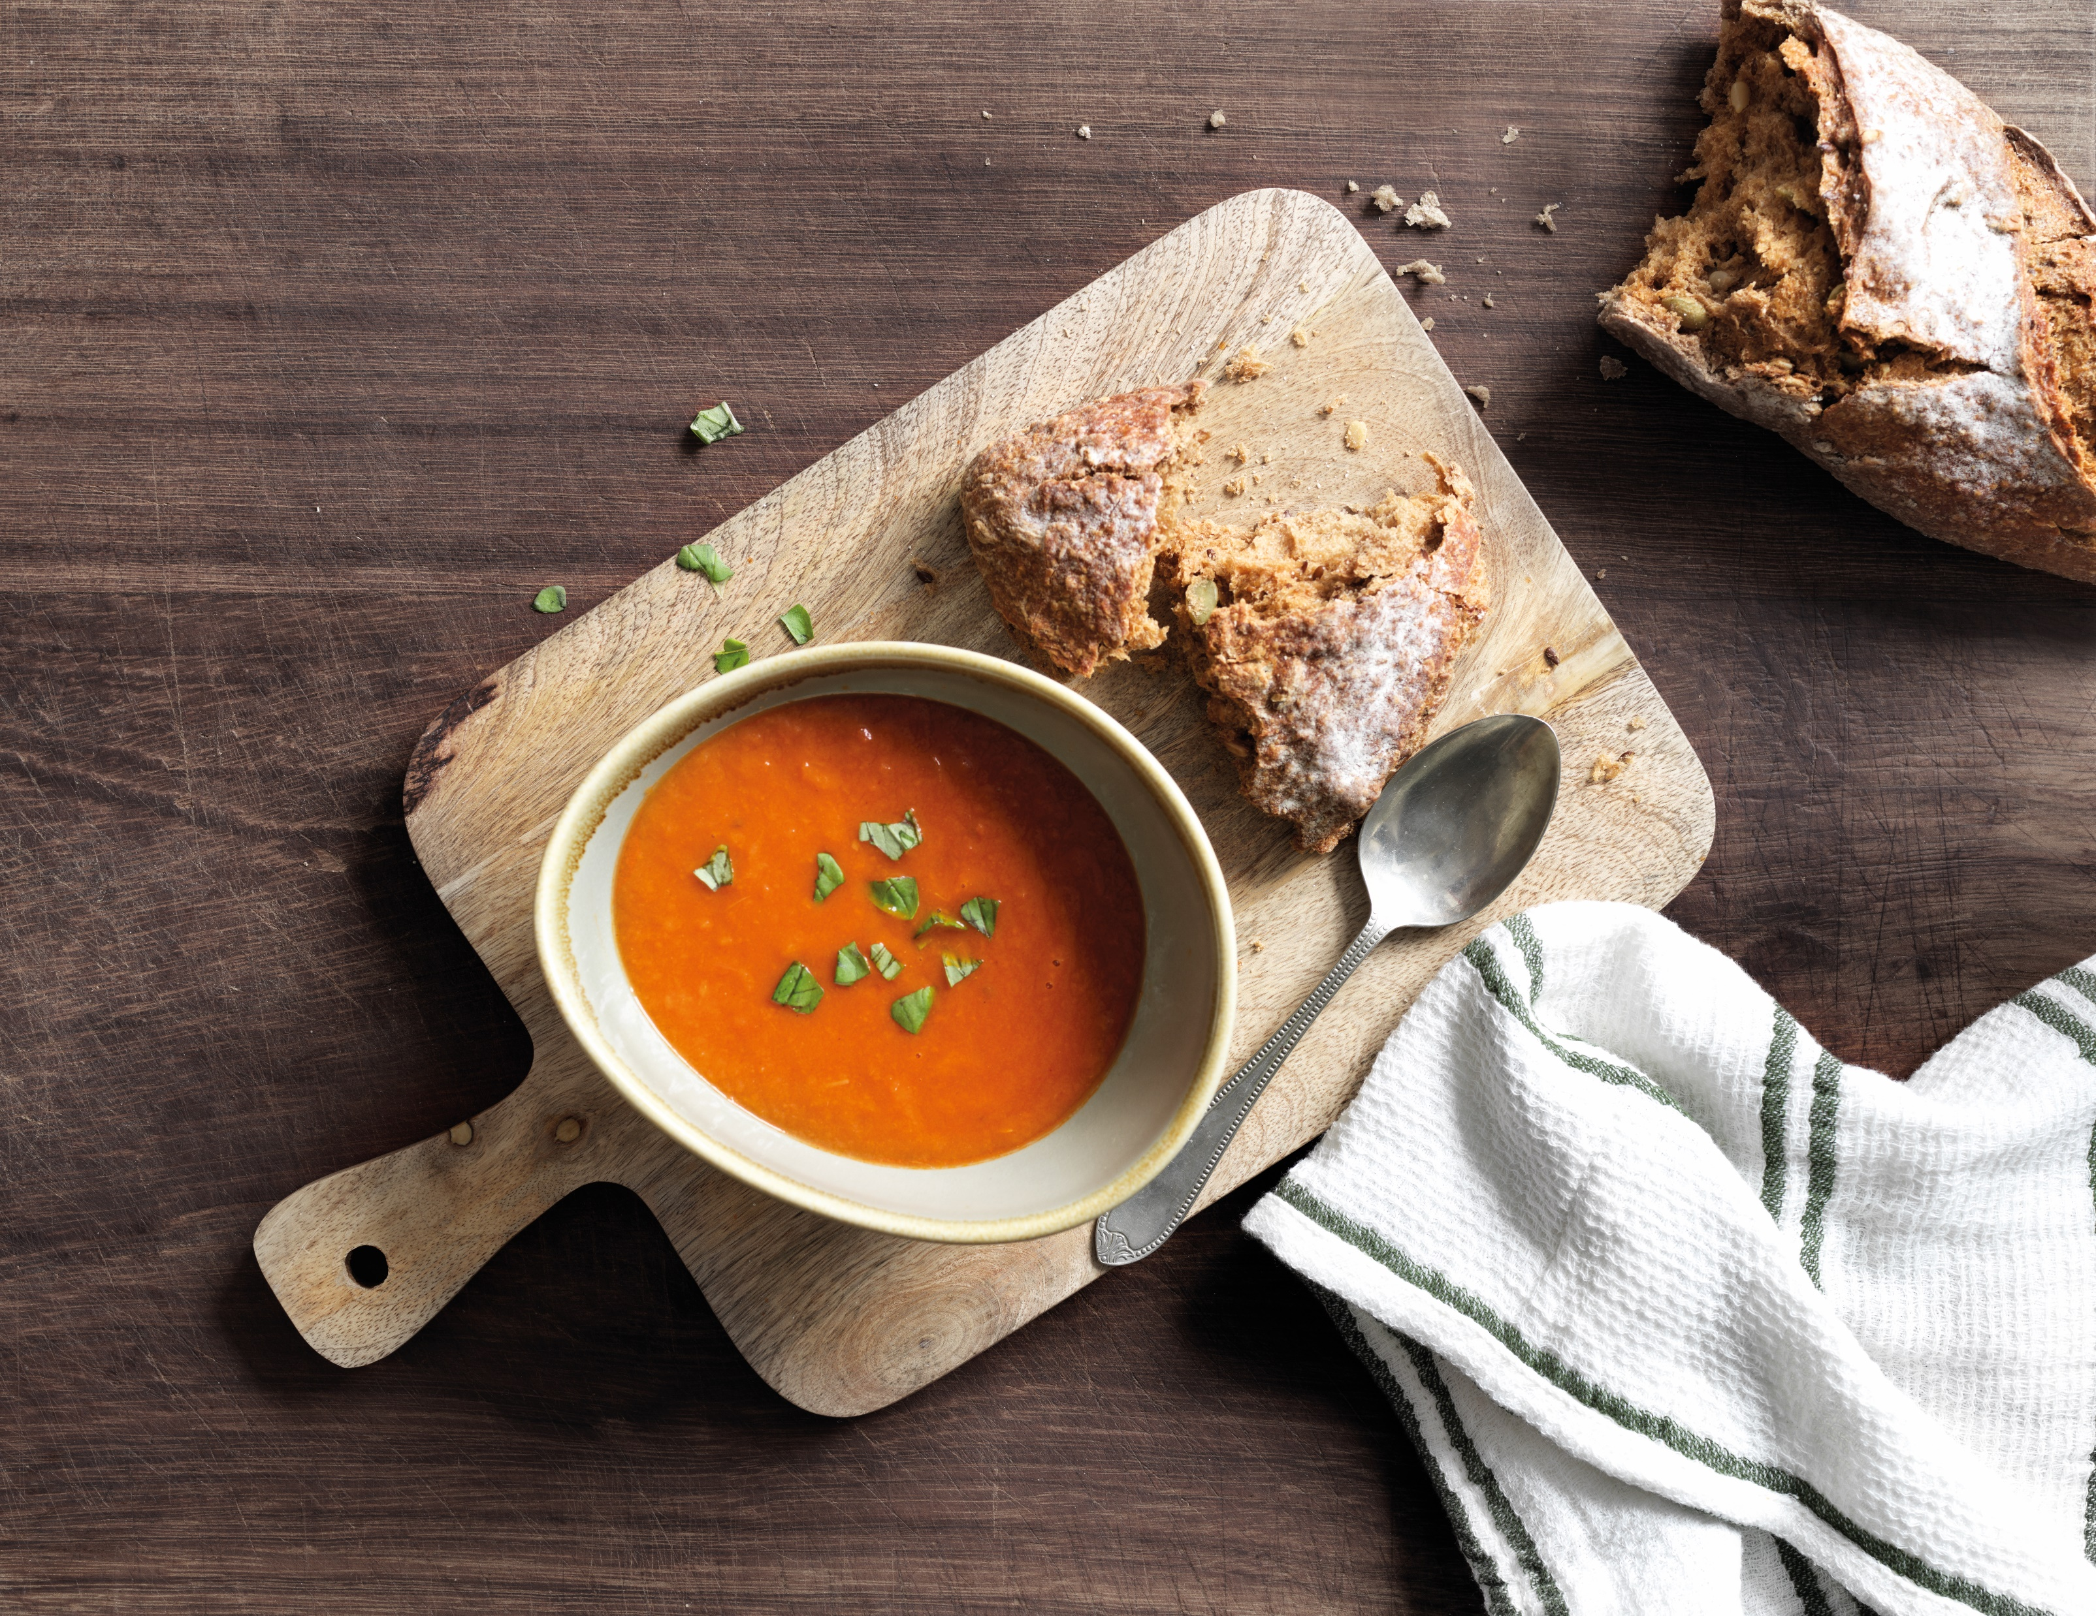
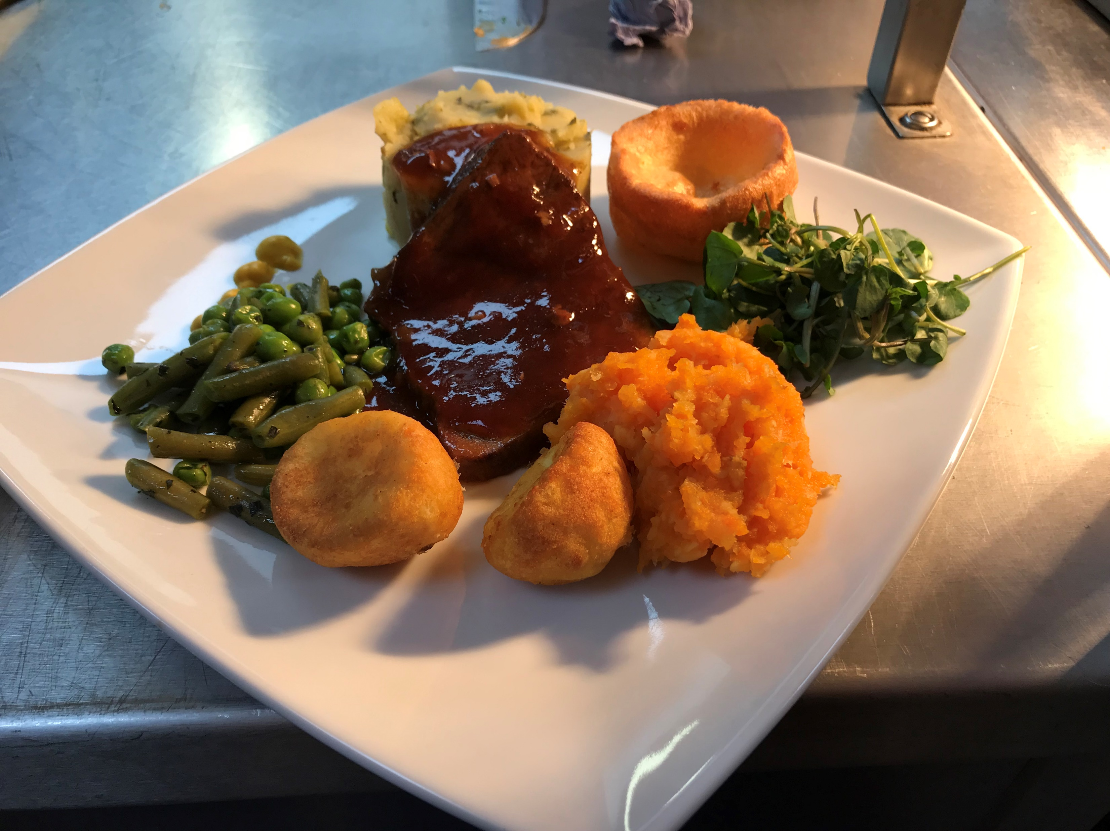
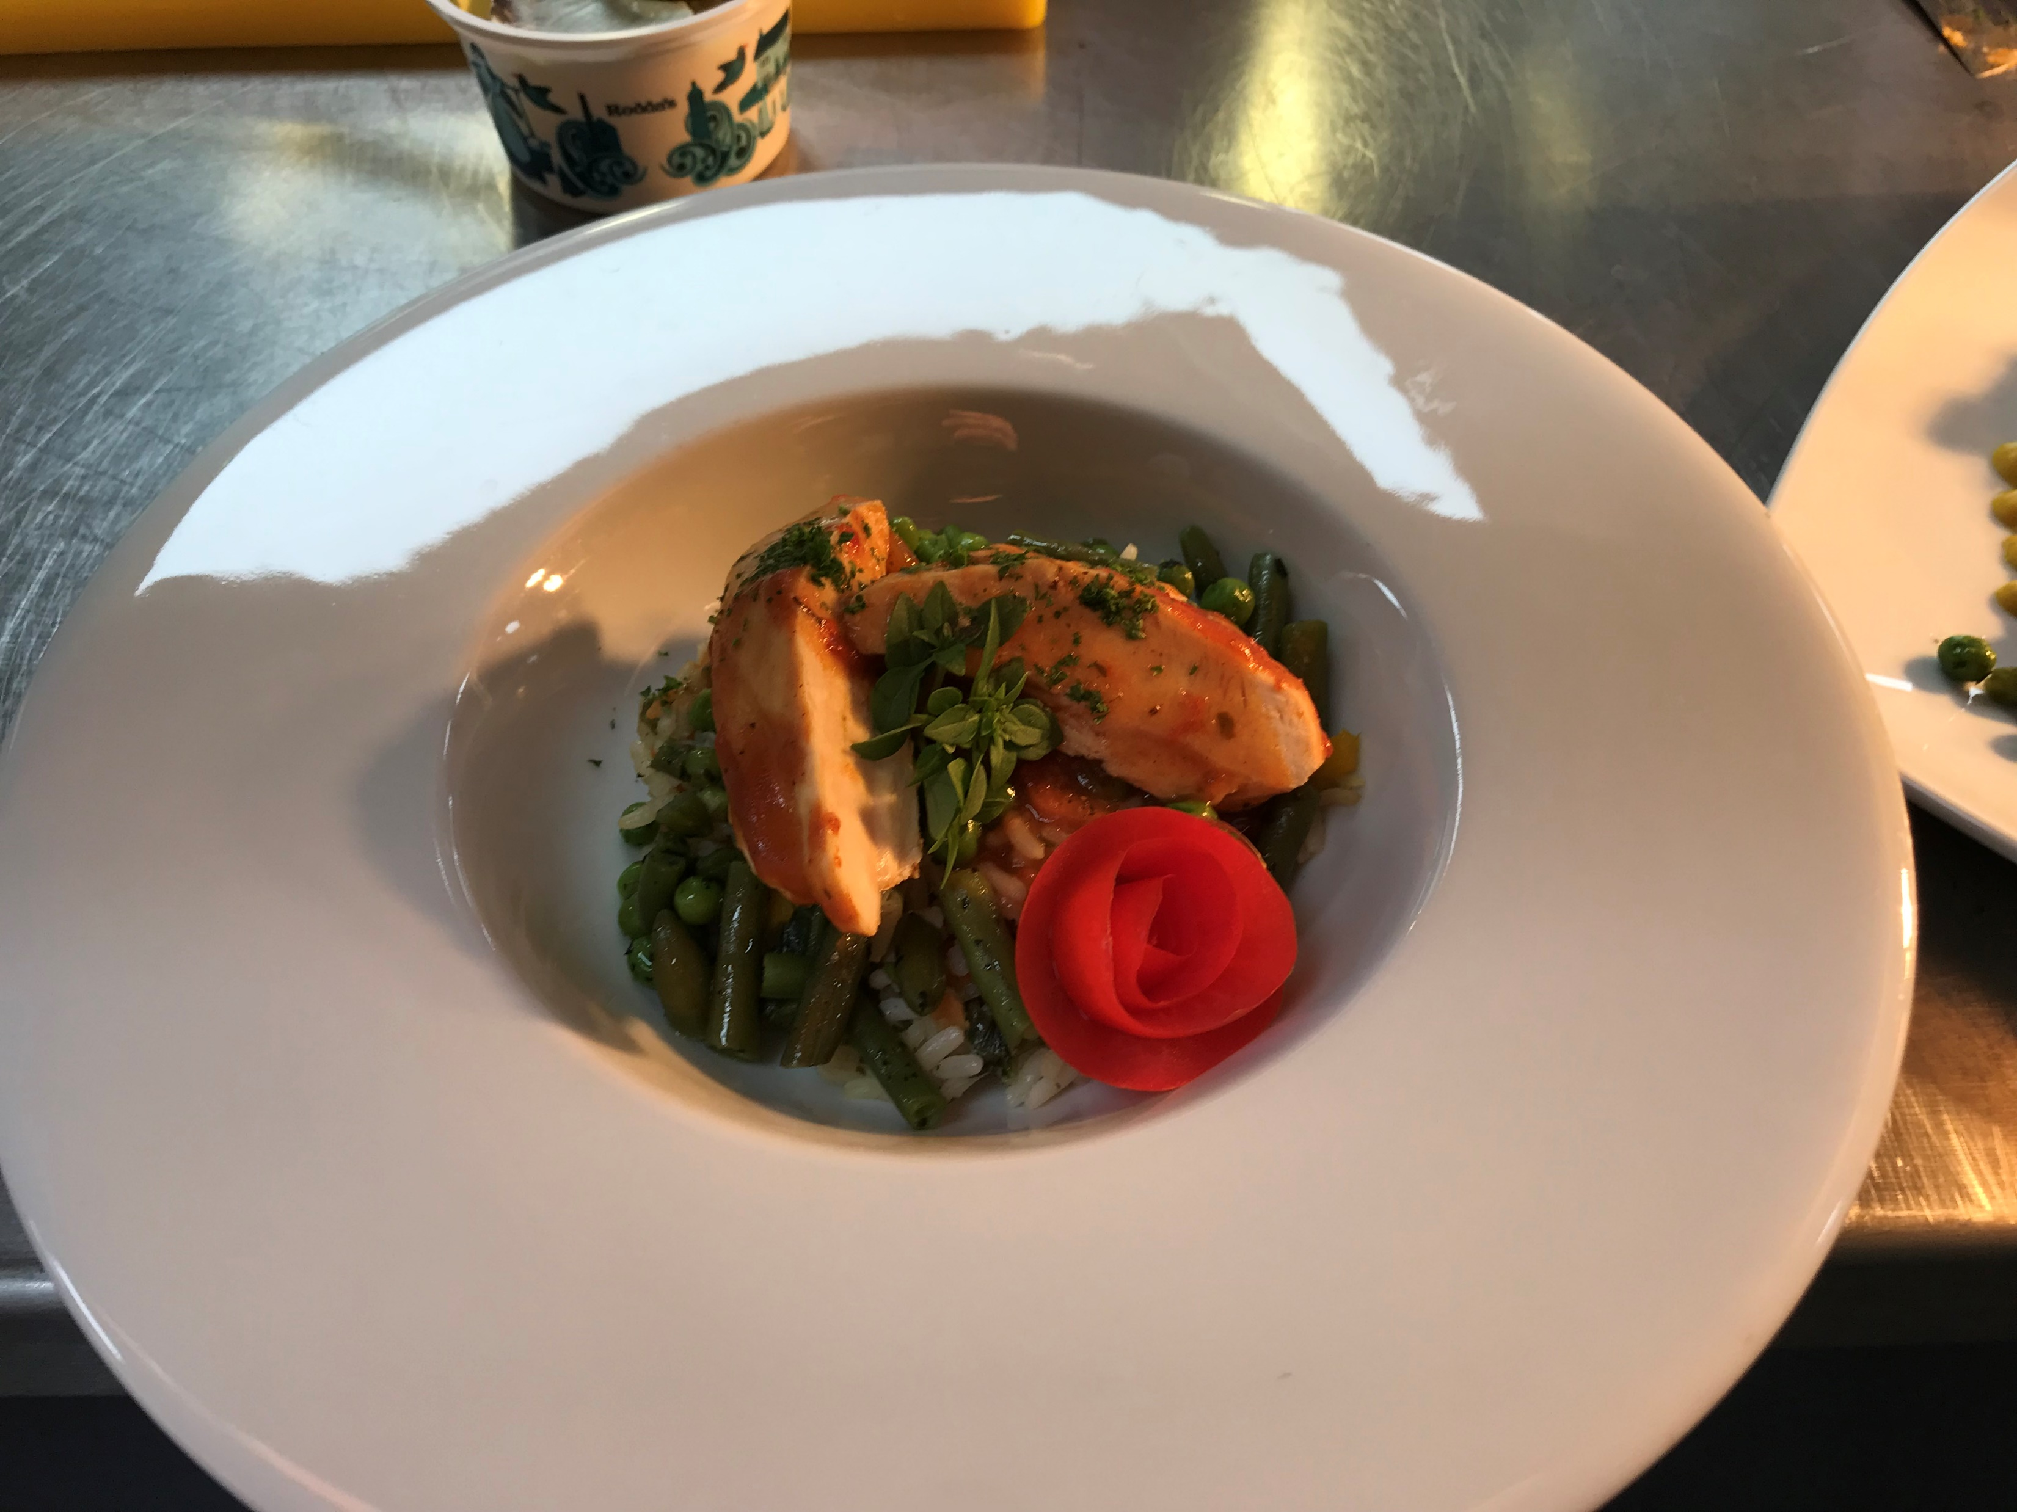
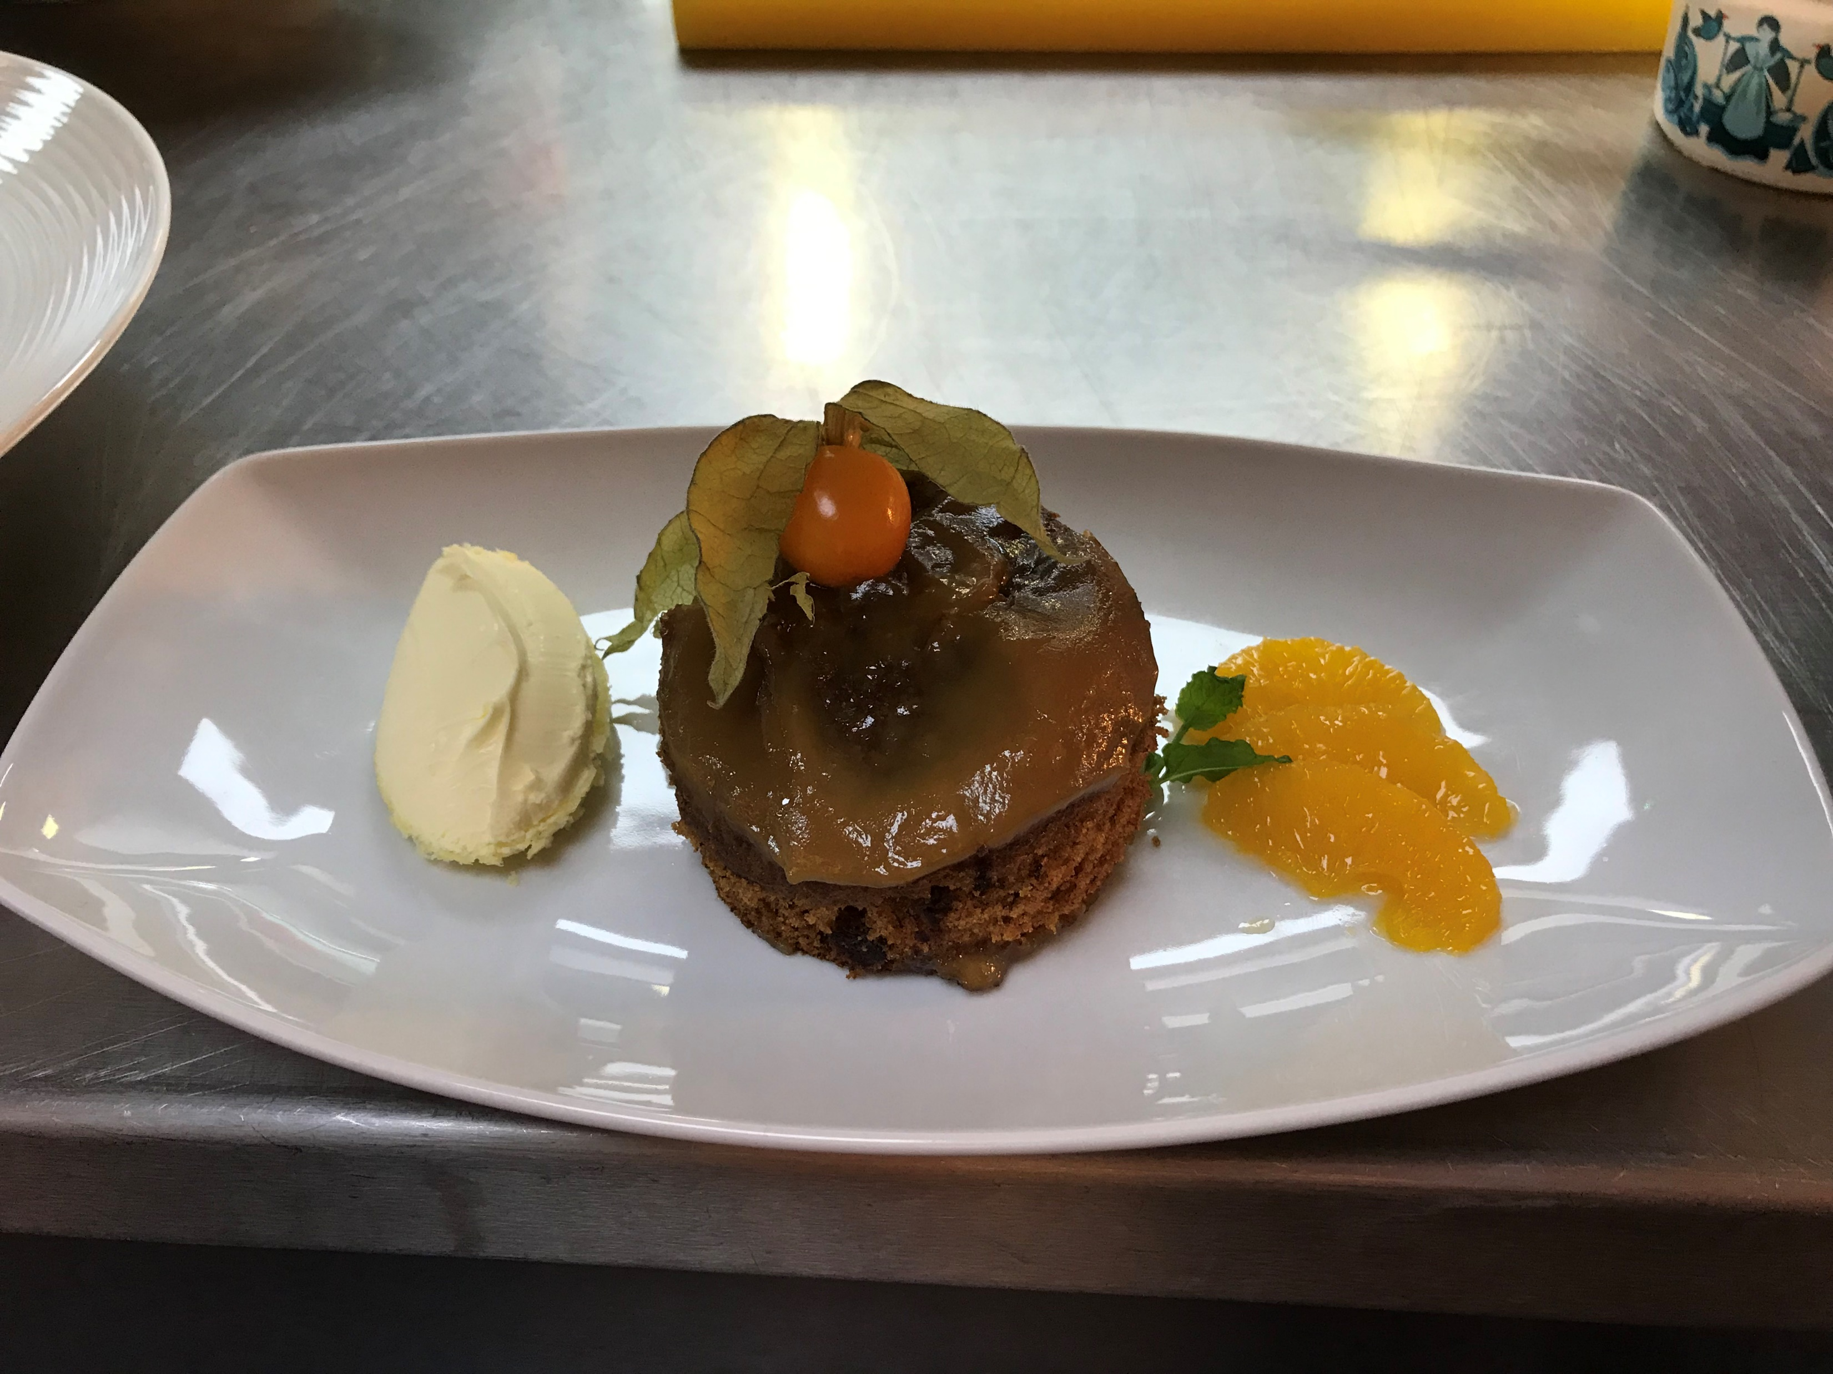
Garnishing Examples
Notes:
1- garnishes on ceramic service- chopped herbs and bunches of herbs used as well as fruit used in the desserts
2- ceramic service garnishing
3- Sticky Toffee Pudding – Clotted Cream , Orange Segments and a physalis
4- Chicken breast in tomato and basil, served with minted summer veg, chopped coriander and a tomato rose
5- Roast beef with roast potatoes, colcannon mash, mashed swede, minted summer veg and a Yorkshire pudding. Garnished with watercress
6- tomato soup. Garnished with chopped parsley. Can also be garnished with cream to break up the colour

Slide 20
Thank you

